Slide 2
Program AGENDA
Setting the Stage
Reminder: What is Trauma-Informed Practice?
Trauma-Informed Practice for Strengthening Relationships and Measuring Progress
Group Work (R.I.C.H. Approach)

Slide 3
PROGRAM OBJECTIVES
After this session, participants will be able to:
Identify the primary component of Trauma-Informed Practice.
Utilized the RICH approach to strengthen partnerships with clients.
Apply two cases to the RICH approach.
Demonstrate their ability to use the RICH approach on a case.

Slide 5
TRAUMA-INFORMED PRACTICE
What is Trauma Informed Practice?
We need to presume that the population we serve have a history of traumatic stress and exercise “universal precautions” by creating systems of care that are trauma-informed (Hodas, 2005).

Slide 6
TRAUMA-INFORMED PRACTICE
NON TRAUMA-INFORMED
TRAUMA INFORMED
Lack of education on trauma prevalence and “universal” precautions
Over-diagnosis of schizophrenia and bipolar and singular addictions
Cursory or no trauma assessment
Recognition of high prevalence of trauma
Recognition of primary and co-occurring trauma diagnoses
Assess for traumatic histories & symptoms

Slide 7
TRAUMA-INFORMED PRACTICE continued
NON TRAUMA-INFORMED
TRAUMA INFORMED
Cursory or no trauma assessment
“Tradition of Toughness” valued as best care approach
Keys, security uniforms, staff demeanor, tone of voice
Assess for traumatic histories & symptoms
Recognition of culture and practices that are re-traumatizing
Power/control minimized – constant attention to culture

Slide 8
Trauma-informed practice continued
Non trauma-informed
Trauma-informed
Rule enforcers – compliance
“Patient-blaming” as fallback position without training
Behavior seen as intentionally provocative
Labeling language: manipulative, needy, “attention-seeking”
Closed system – advocates discouraged
Caregivers/supporters – collaboration
Address training needs of staff to improve knowledge & sensitivity
Staff understand function of behavior (rage, repetition-compulsion, self-injury)
Objective, neutral language
Transparent systems open to outside parties

Slide 9
PRIMARY COMPONENTS OF TRAUMA-INFORMED PRACTICE
The following six core components of trauma-informed practice have been synthesized from the current research literature on trauma:
1) acknowledgment
2) safety
3) trustworthiness
4) choice and control
5) relational and collaborative approaches
6) strengths-based empowerment modalities

Slide 10
COMPONENT OF ACKNOWLEDGEMENT
Understanding the pervasiveness of trauma and the impact it has on every aspect of life.
Accepting the pervasiveness of trauma without expecting disclosure of it by the client.
Reframing trauma responses by redefining the perception of ‘problem behaviors’.
Encouraging the process of change with respectful and trauma-informed support.

Slide 11
Component of safety
Recognizing the many aspects involved in creating an environment of safety for clients who have experienced trauma, including emotional, psychological, physical, and cultural safety.
Emphasizing relationship building, providing flexible services where possible.
Ensuring safety for everyone in the organization, including other clients and staff.
Finding ways to increase emotional and physical safety in services environments.

Slide 12
Component of trustworthiness
Understanding the patience and respect required to build a therapeutic relationship with clients who have experienced trauma
Determining and communicating clear boundary guidelines

Slide 13
Component of trust & control
Understanding the connections among choice, control, and safety
Acknowledging the strong emotional and psychological impacts that enhanced choice and control can have for clients who have experienced trauma

Slide 14
Component of relational collaboration
Recognizing the place of relational approaches in providing respectful and compassionate care.
Acknowledging that collaboration between service providers and clients has far-reaching impacts.

Slide 15
Strength-based empowerment modalities component
Recognizing the crucial role that self-efficacy plays in supporting change for clients who have experienced trauma.
Emphasizing hope, optimism, and resilience.

Slide 16
A review of trauma-informed practices from the trauma tool kit
Strategies to
Maximize the child’s/youth’s sense of safety.
Strategies to
Help the youth make new meaning of their trauma history and new experiences
Strategies to
Address the impact of trauma on the youth’s behavior, development and relationships
Strategies to
Support and promote positive relationships
Strategies to
Provide support and guidance to the caregivers

Slide 17
Trauma defined
The experience of violence and victimization including sexual abuse, severe neglect, loss, domestic violence and/or the witnessing of violence, terrorism or disasters. (NASMHPD, 2006)
Trauma is a psychological distressing event that is outside the range of usual human experience. (Perry, 2002)
Trauma is an unusually severe stressor or event that causes or is capable of causing death, injury, or threat to physical integrity of self or others. (Baggerly, 2008)
Trauma is accompanied by intense feelings of horror, terror or helplessness. (Baggerly, 2008)
Seriously threatens the health or survival of the individual.
Renders the individual powerless in the face of overwhelming fear or arousal.
Overwhelms the individual’s coping capacity.
Violates the basic assumptions about the safety of the environment and trust of others. (Forrest-Perkins, 2011)

Slide 18
Levels of trauma
Level i
Level ii
A Single incident of trauma
Examples of a Type I trauma would include, experiencing a natural disaster, a house fire, a onetime violent crime.
A prolonged or repeated trauma.
Examples of a type II trauma would be repeated bullying, sexual abuse, harassment or witnessing repeated domestic violence.
Repeated combat in war. (Baggerly J. & Exum H.A. 2008)

Slide 19
Trauma-informed care
Trauma-Informed Care is an approach to engaging people with histories of trauma that recognizes the presence of trauma symptoms and acknowledges the role that trauma has played in their lives. National Center for Trauma Informed Care (NCTIC, www.samsha.gov/nctic, 2013)

Slide 20
The MANY faces of trauma
The human cost to address trauma is high. There are many faces of unaddressed trauma – and many paths the impact of such traumas can travel.

Slide 21
Faces of trauma

Slide 22
TRAUMA REVEALED – THE NUMBER’S GAME
56% of general adult sample reported at least one traumatic event (Kessler et al., 1995)
90% of mental health clients have been exposed to a traumatic event and most have multiple experiences of trauma. (Muesar, 1998)
75% of women and men in substance abuse treatment report abuse and trauma histories. (SAMHSA/CSAT, 2000)
97% of homeless women with mental illness experienced severe physical and/or sexual abuse, 87% experienced this abuse as children and as adults. (Goodman, Dutton et al., 1997)
92% of incarcerated girls reported sexual, physical or severe emotional abuse in childhood. (Acoca & Dedel, 1998)

Slide 23
The numbers game continued
Being abused or neglected as a child increases the likelihood of arrest as a juvenile by 59%. (Widom, 1995)
3 million children are suspected of being victims of abuse and/neglect. (Mazelis, 1999)
Arrest rates of trauma-exposed youth are up to 8 times higher than community samples of same-age peers. (Saigh et al, 1999; Saltzman et al, 2001)
Abused children are more likely to…
Be in special education
Have below-grade-level achievement test scores
Have poor work habits
Fail a grade (Shonk, et al. 2001)

Slide 24
Here’s A Trauma-Informed Approach You Can Use To Strengthen Relationships & Measure Progress!

Slide 25
The r.i.c.h. approach
At its core, RICH is fundamental to the therapeutic relationship between client/consumer and provider. In a therapeutic relationship, the essential building blocks of safety and trust are fostered and developed. These building blocks are essential to healing human connections.

Slide 26
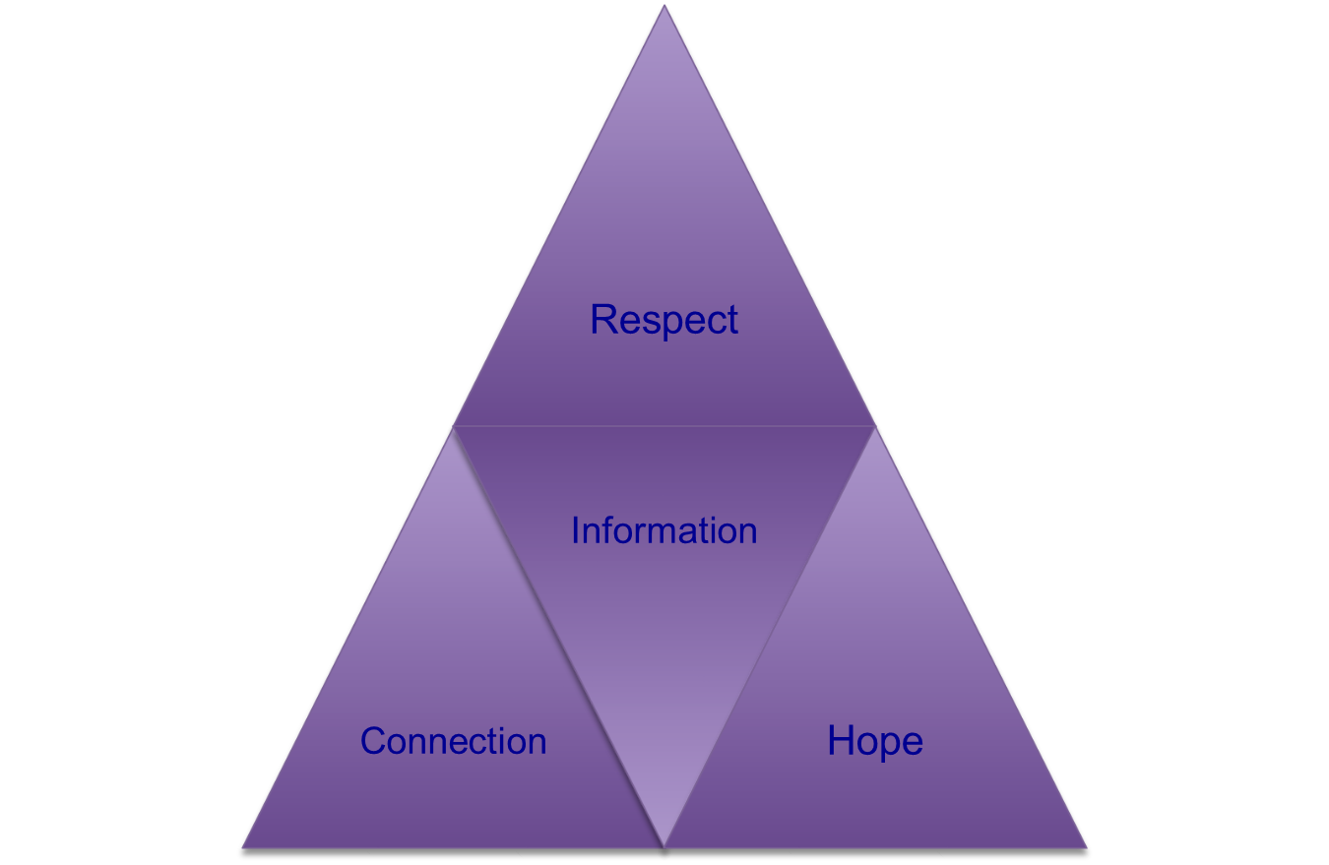
The r.i.c.h. approach

Slide 27
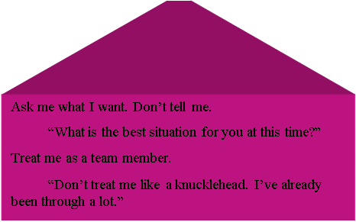
R-E-S-P-E-C-T

Slide 28
RESPECT CONTINUED
When treating a client with respect, the following should be kept in mind:
Collaboration: work with the client, not against the client. The journey to recovery is a collaborative effort between client and provider. The client has an equal voice which leads to empowerment
Confidentiality: whatever is discussed between client and provider must be held in the strictest confidence. Otherwise trust would be eroded.
Sensitive language: avoid labeling. Both spoken and written language should be trauma-informed.

Slide 29
Respect continued
Being fully present: give the client you undivided attention. Be fully engaged.
Humility: providers must exercise humility in the process. It is a privilege for clients to share their trauma narratives with providers, not a right.
Honesty: providers should tell clients the truth, regarding program pitfalls, at all times, even when it means a possible setback.

Slide 30
Watch your language use helpful language
UNHELPFUL ASSUMPTIONS
HELPFUL RESPONSES
“This person is sick.”
“They are weak.”
“They should be over it already.”
“They are making it up.”
“They want attention.”
“This person is a survivor of trauma.”
“They are stronger for having gone through the trauma.”
“Recovery from trauma is a process and takes time.”
“This is hard to hear, and harder to talk about.”

Slide 31
Watch your language use helpful language
Unhelpful responses
Helpful responses
“Don’t ask them about it or they will get upset.”
“They have poor coping methods.”
“They’ll never get over it.”
“They are permanently damaged.”
“They are crying out for help.”
“Talking about the trauma gives people permission to heal.”
“They have survival skills that have got them to where they are now.”
“People can recover from trauma.”

Slide 32
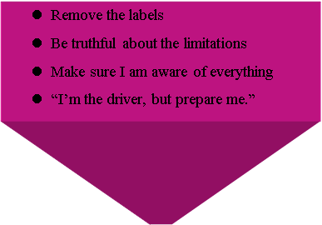
INFORMATION – Individualize the information

Slide 33
INFORMATION – Individualize the information!
Provide information about effects of trauma
Make sure consumer is comfortable and feels safe when engaged in a trauma conversation
Provide clear information about the services that will be available for the client at the organization.
Explain treatment plan, including rationale
Include possible risks and benefits
Expectations on both sides should be clear and reviewed as often as needed.

Slide 34
INFORMATION – Individualize the information!
Inform before preforming – continually inform the client of what is going to happen during healthcare encounters and assessments (Havig, 2008).
Make community resources available
Safety planning
In inpatient/correctional setting, helping client understand the process
One size does not fit all. Treatment plans should be individualized

Slide 35
CONNECTION
Connection takes place on three levels. (1) reconnecting with SELF (mind, heart, and body), within a group setting; (2) reconnecting with SELF (mind, heart, and body) in the real world; and (3) connecting with people and resources who can actually help the client.

Slide 36
CONNECTION
REMEMBER TO ….
EXAMPLES OF BOUNDARIES
SHOW Genuine empathy and positive regard
SET Clear boundaries: boundaries work for survivors
Be honest
Sit with painful content and emotions
Use connections to help clients manage their feelings and memories
Recognize that the work affects both of you
Availability
Personal disclosure
Touch
Fees
Gifts
Tolerance for acting out behavior
Social contact

Slide 37
hope
You can have hope for the client even when she doesn’t have it for herself
Utilize strengths and abilities
Inquire about client’s strengths and coping strategies
Assist clients to consider how well those coping strategies have served them in the past and if they are still effective.
Are there ways in which coping strategies may be creating difficulties for her at present?

Slide 38
Hope continued
Acknowledge a client’s ability to transcend adversity
Help client see progress
Keep goals realistic
Goals that are set for clients should always be S – M – A – R - T
SPECIFIC
MEASURABLE
ATTAINABLE
REALISTIC
TIMELY

Slide 39
Hope continued
Make reference to the client as a “survivor”, and focus on healing and recovery as “possible”.
Therapist self-care is crucial!
Providers must find a balance between care-giving and self-care.
Failure to strike a balance can result in the adverse effects of burnout, vicarious trauma, compassion stress, and compassion fatigue.
To help avoid these adverse effects, Pearlman & Saakvitne suggests implementing the ‘ABC Model’ as part of a self-care strategy:
Awareness: attunement to one’s needs, limits, emotions, and resources
Balance: balancing the multiple aspects of self & one’s activities
Connection: to oneself, to others, and to something larger

Slide 40
triggers
Flashbacks are trauma memories that have not been verbally integrated and come back in the form of sensory memories that make it feel as if the trauma were occurring again in the here and now.
Trauma Triggers
Flashbacks are most often triggered by a non-verbal memory, to wit:
Sights
Sounds
Smells
Bodily sensations
Emotional reactions
Motor memories

Slide 41
Triggers continued
Simple Trauma
Seeing, feeling, hearing, smelling something that reminds us of past trauma
Activate the alarm system
The response is as if there is current danger
Thinking brain automatically shuts off in the face of triggers
Past and present danger become confused
Complex Trauma
More reminders of past danger
Brain is more sensitive to danger
Interactions with others often serve as triggers

Slide 42
Triggers continued
Common Triggers
Reminders of past events
Lack of power/control
Separation or loss
Transitions and routine/schedule disruption
Feelings of vulnerability and rejection
Feeling threatened or attacked
Sensory overload

Slide 43
Applying the r.i.c.h. model
CASE STUDY #1: Jenny from the Block
CASE STUDY #2: Who’s Johnny

Slide 44
exercise
Who is thinking in a manner which utilizes a trauma-informed approach?
What makes their thought process trauma-informed?
What is the potential impact of this type of approach for client(s) in the case study?
How will interacting with the client(s) in this way most likely to make them feel?

Slide 45
Exercise CONTINUED
Which advocates (if any) are approaching the client(s) utilizing a traditional approach?
What makes the approach more traditional?
What is the potential impact of this traditional approach for the client(s)? That is, how will interacting with the client(s) in this continued manner most likely impact their experience and make them feel?

Slide 46
Exercise CONTINUED
What are some explanations for the client(s) reactions?
What effect did the client(s) traumatic journey have on them?
What rules of the service delivery organization may impede the client(s) need(s) at this time?
What would be the best approach in speaking with the client about behaviors?

Slide 47
Exercise CONTINUED
How can advocates be mindful of a new client’s perspective?
What are some of the client’s potential triggers from the past traumas?
What are ways you as an advocate can be a trauma champion?

Slide 48
Wrap up
Thank you for your time and attention to this most important work
For more information about the services that Healing Neen™ offers, please contact us at Post Office Box 175, Arnold, MD 21012 or email us at ca4toni@aol.com.

