Slide 1
The Yellow List
Credit: Juliet Funt, CEO of WhiteSpace at Work

Slide 2
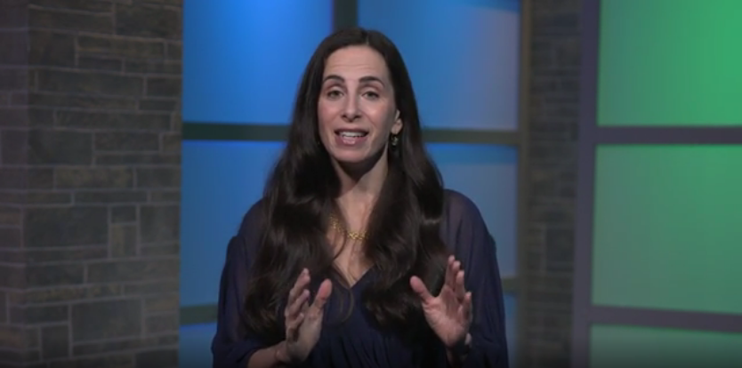
Attack Email Clutter Using the Yellow List
Notes:
https://globalleadership.org/videos/leading-yourself/attack-email-clutter-using-the-yellow-list

Slide 3
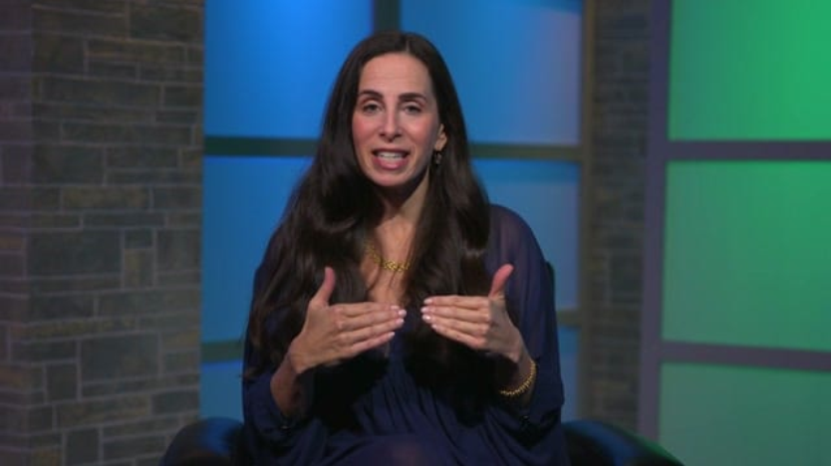
Different Levels of Email Time Sensitivity
Notes:
https://globalleadership.org/videos/leading-yourself/different-levels-of-email-time-sensitivity

Slide 4
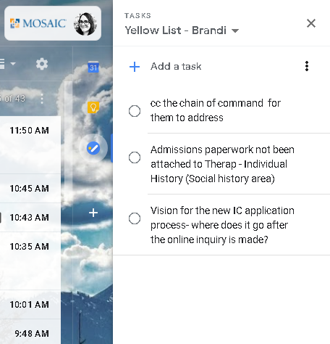
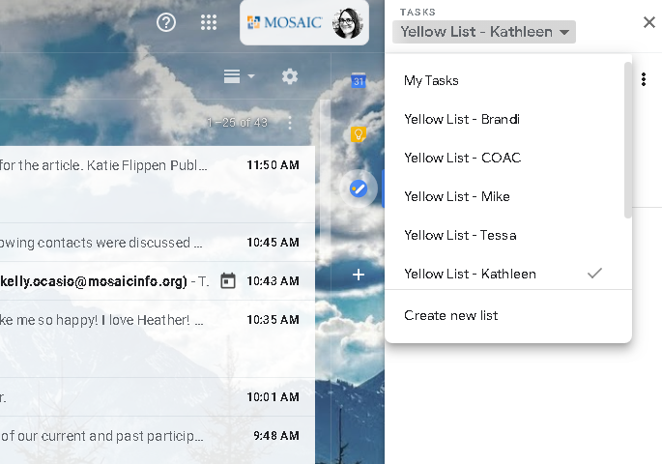
What does a yellow list look like?

Slide 5
Practical application
Evaluate
Implement A yellow list
Evaluate the urgency of the message. Is there a hallucinated urgency in your message or the messages you receive?
Would this be more efficient or effective to communicate in person?
Paper vs Electronic
Schedule “yellow list” meetings

Slide 6
The Yellow List
Credit: Juliet Funt, CEO of WhiteSpace at Work

