Slide 1

Aging and Dementia: The Graying of Individuals with Intellectual & Developmental Disabilities
2019 DD/ID Workshop
Rick Rader, MD

Slide 2
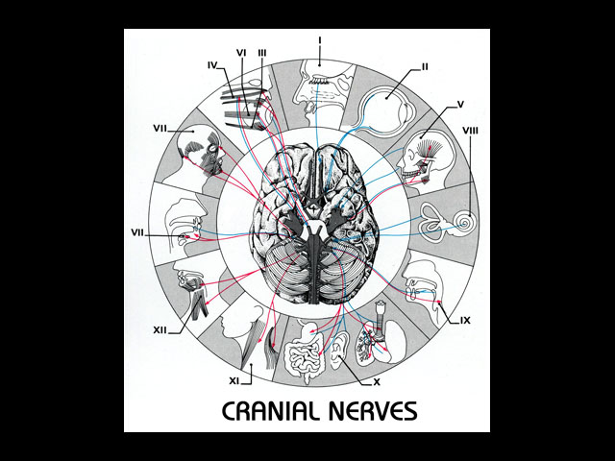

Slide 3


Slide 4
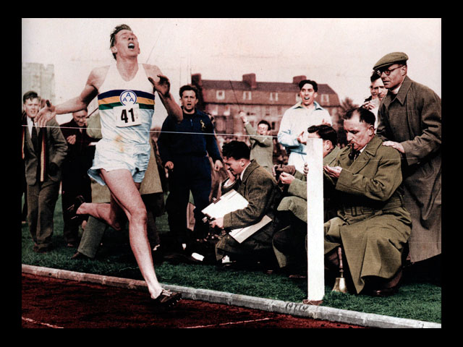

Slide 5


Slide 6

“Dr. Rader why exactly are you
going to Des Moines?”

Slide 7


Slide 8
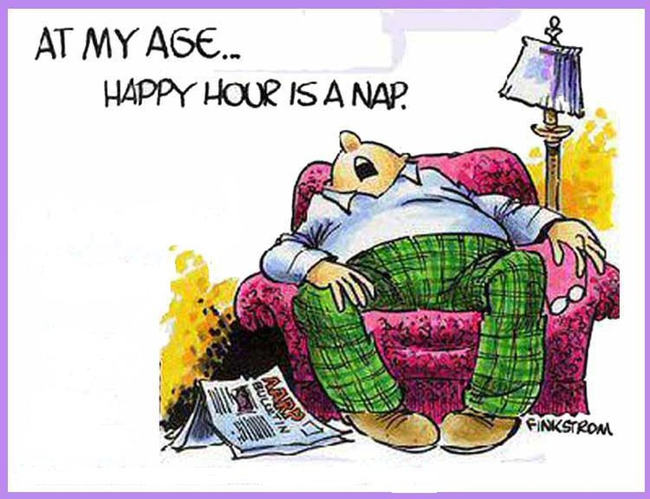

Slide 9
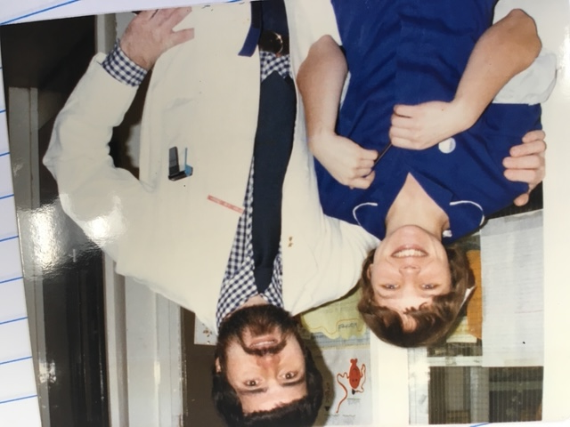

Slide 10


Slide 11

Fountain of Youth

Slide 12
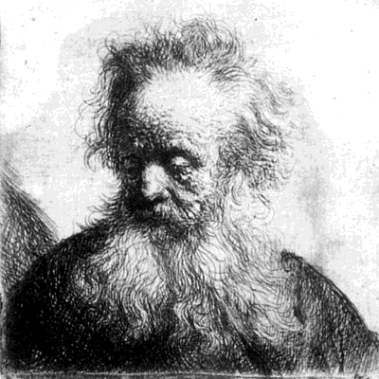
Methuselah

Slide 13

Jeanne Calment

Slide 14
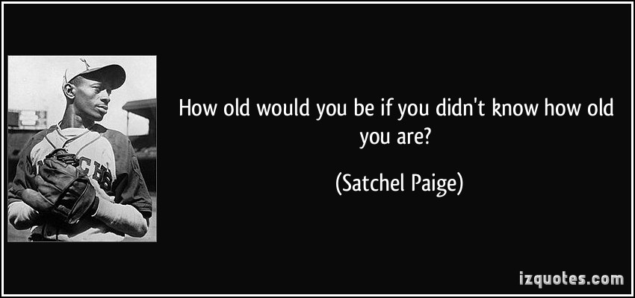
Satchel Paige

Slide 15
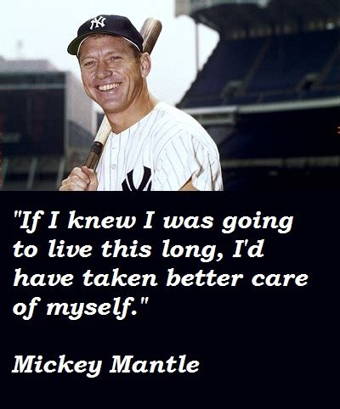

Slide 16
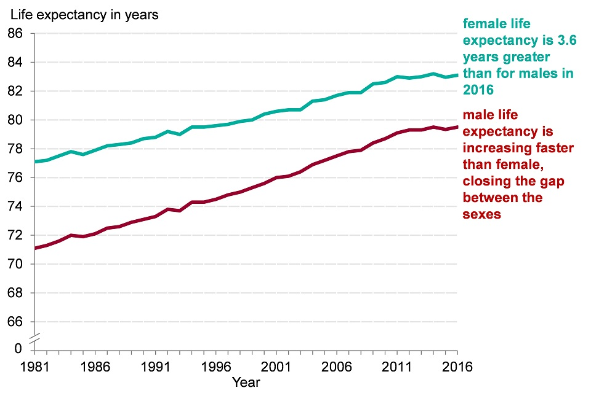
Lacrosse at Adelphi
Life Expectancy Chart

Slide 17
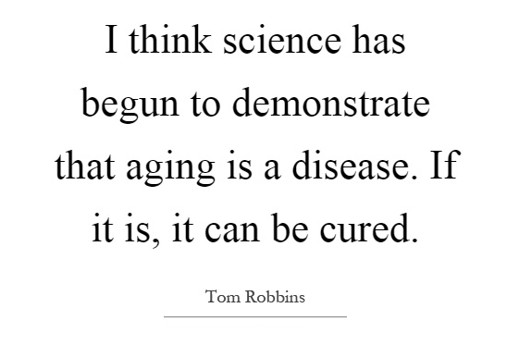

Slide 18
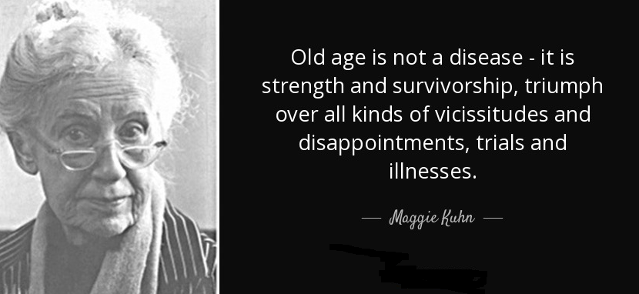

Slide 19

Lacrosse at Adelphi
Can We Predict How Long You’ll Live

Slide 20
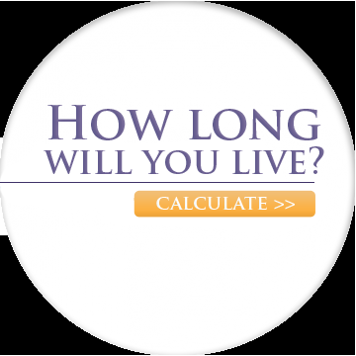
Lacrosse at Adelphi
Calculate How Long You Will Live

Slide 21

Calculate How Long You Will Live
Or are some thing best left unknown?
Something you should know?
media.nmfn.com/tnetwork/lifespan

Slide 22

Lacrosse at Adelphi
Ageism is up there with
Racism, Sexism, and Ableism

Slide 23

Lacrosse at Adelphi
How the Body Ages
Some Normal Changes

Slide 24

HOW THE BODY AGES:
Some Normal Changes
WHAT HAPPENS?
Mental Function
Difficulty remembering or coming up with the right word. WHY?
Difficulty concentrating. WHY?
Difficulty learning new material WHY?

Slide 25

HOW THE BODY AGES:
Some Normal Changes
WHAT HAPPENS?
Lacrosse at Adelphi
PHYSICAL ACTIVITY
Unsteadiness or loss of balance. WHY?
Dizziness or light-headedness when standing. WHY?
Loss of muscle strength. WHY?

Slide 26
HOW THE BODY AGES:
Some Normal Changes
WHAT HAPPENS?
PHYSICAL ACTIVITY (cont.)
Difficulty moving. WHY?
Less flexibility. WHY?
Difficulty exercising strenuously. WHY?

Slide 27

Lacrosse at Adelphi
HOW THE BODY AGES:
Some Normal Changes
WHAT HAPPENS?
THE SENSES: VISION
Need for reading glasses. WHY?
Difficulty seeing in dim light. WHY?
Difficulty adjusting to changes light levels. WHY?
Dry eyes. WHY?

Slide 28
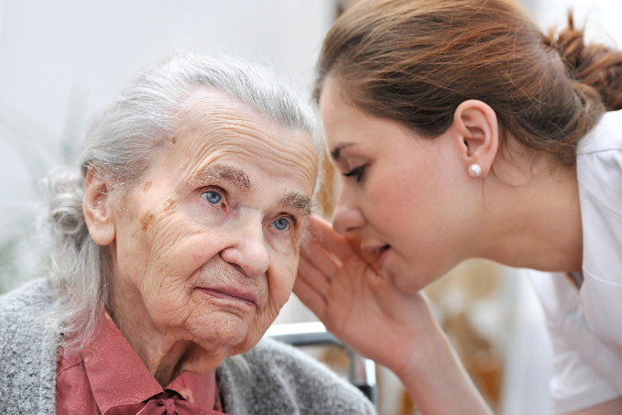
HOW THE BODY AGES:
Some Normal Changes
WHAT HAPPENS?
THE SENSES: Hearing
Difficulty understanding words. WHY?
Hearing loss. WHY?

Slide 29

HOW THE BODY AGES:
Some Normal Changes
WHAT HAPPENS?
Taste
Eating Problems. WHY?
Difficulty Swallowing. WHY?
Disinterest in Eating. WHY?

Slide 30
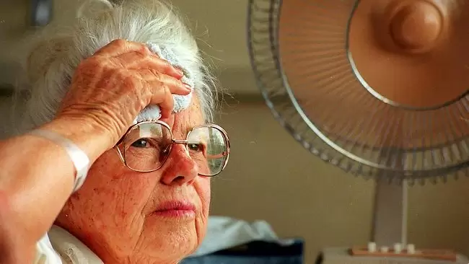
HOW THE BODY AGES:
Some Normal Changes
WHAT HAPPENS?
SKIN AND HAIR
WRINKLES WHY?
MORE TEARS IN THE SKIN. WHY?
BRUISES AND BROKEN BLOOD VESSELS. WHY?
SLOW HEALING OF WOUNDS. WHY?
DIFFICULTY ADJUSTING TO CHANGES IN TEMPERATURE. WHY?

Slide 31

HOW THE BODY AGES:
Some Normal Changes
WHAT HAPPENS?
SKIN AND HAIR – (cont.)
THINNING OR LOSS OF HAIR. WHY?
GRAY OR WHITE HAIR. WHY?
DECREASED SENSATION AND SENSITIVITY TO PAIN. WHY?

Slide 32

HOW THE BODY AGES:
Some Normal Changes
WHAT HAPPENS?
BLADDER DYSFUNCTION
FREQUENCY
NOCTURIA
STRESS INCONTINENCE

Slide 33
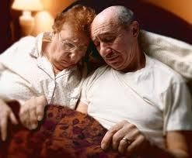
HOW THE BODY AGES:
Some Normal Changes
WHAT HAPPENS?
SEXUAL DYSFUNCTION
WHY?????

Slide 34
HOW THE BODY AGES:
Some Normal Changes
WHAT HAPPENS?
EVERYTHING YOU NEED TO KNOW ABOUT AGING YOU CAN LEARN FROM THE SEVEN DWARFS…

Slide 35

HOW THE BODY AGES:
Some Normal Changes
WHAT HAPPENS?
EVERYTHING YOU NEED TO KNOW ABOUT AGING YOU CAN LEARN FROM THE SEVEN DWARFS…
BUT NOT THESE DWARFS…

Slide 36
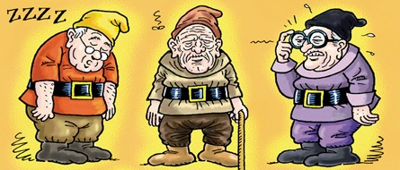
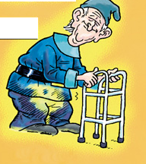
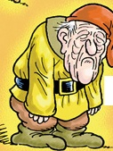
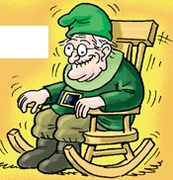
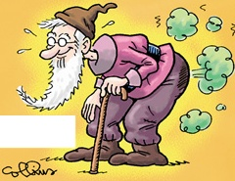
THESE DWARFS

Slide 37
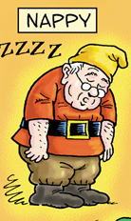
INTRODUCING

Slide 38
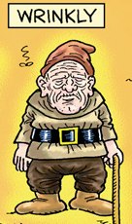
INTRODUCING

Slide 39
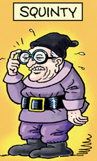
INTRODUCING

Slide 40
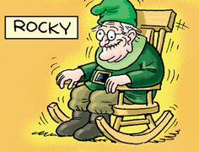
INTRODUCING

Slide 41
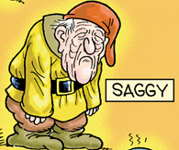
INTRODUCING

Slide 42
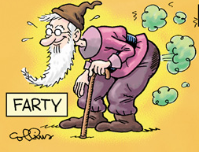
INTRODUCING

Slide 43
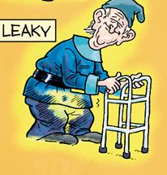
INTRODUCING

Slide 44
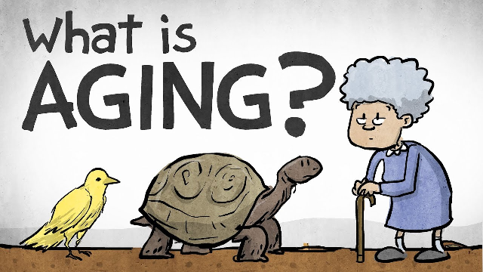
What is Aging?
Active process that occurs over an individual’s lifespan, from birth until death.
Aging is unique to each person.
  Marked by gains and losses within common patterns of aging.
Conditions that impact aging:
  Genetics
  Lifestyle
  Environment
  Attitude
NTG Education & Training Curriculum on Dementia and ID. Copyright 2014. All rights reserved.
44
Notes:
Genetics
Lifestyle – Diet, exercise, smoking, support networks including family and friends
Environment – social and physical
Attitude
44

Slide 45

Adopt a Lifespan Approach
Based on the premise that what happens in childhood and young adulthood affects the quality of life in old age.
It’s never too late to make a difference, but the earlier we start the larger difference we can make.
NTG Education & Training Curriculum on Dementia and ID. Copyright 2014. All rights reserved.
45
Notes:
Factors from childhood affecting quality of life in old age:
Use or over-use of therapies
Nutrition
Weight-bearing exercise
Exposure to sunlight
Emotional equilibrium (staying in psychological balance)
45

Slide 46
Factors Impacting Healthy Aging
Healthy aging is impacted by the following factors:
  Poor lifespan health practices
  Long-term consequences of early-life therapeutic interventions
    Ex. Post polio syndrome
  Prolonged usage of medications adding to chronic conditions in older age (adverse drug reactions & polypharmacy)
    Ex. Thorazine
Continued on next slide.
NTG Education & Training Curriculum on Dementia and ID. Copyright 2014. All rights reserved.
46
Notes:
46
Added functional impairment is the result of early-life onset conditions compounded by interactions with older-age onset conditions

Slide 47
continued
  Problems with accessing health services
    Not having medical personnel familiar with ID
    Not tracking risk conditions
  Age-associated pathologies
    Dementia, cardiovascular disease, etc.
  Lack of exercise
  Poor nutrition and bad eating habits
    Ex. Chewing, swallowing problems in Cerebral Palsy
NTG Education & Training Curriculum on Dementia and ID. Copyright 2014. All rights reserved.
47
Notes:
47
Source?

Slide 48
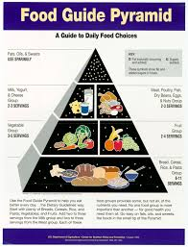
Nutrition is Important
Important determinant of health and well-being throughout the lifespan.
Known risk factors for developing dementia:
    Diabetes, obesity, vascular disease
10% or more weight loss may be indicative of serious disease or illness.
NTG Education & Training Curriculum on Dementia and ID. Copyright 2014. All rights reserved.
48
Notes:
References
1. Editors. What is nutrition? Am J Clin Nutr 77 (5):1093. Available at http://ajcn.nutrition.org/content/77/5/1093.full.pdf+html
48

Slide 49

Challenges to Healthy Aging in Adults with ID
Medical history is often incomplete or unknown.
  Staff turnover
  Family not available for information,
  historical documentation unavailable
  Health care provider turn over
  Providers not understanding baseline functioning of the presenting older adult with ID
NTG Education & Training Curriculum on Dementia and ID. Copyright 2014. All rights reserved.
49

Slide 50

Challenges to Healthy Aging in Adults with ID
Lack of systems for health advocacy :
  Information provided for the appointment may not include all necessary information.
  Staff/family attending health care appointments may not be the most knowledgeable about the symptoms.
NTG Education & Training Curriculum on Dementia and ID. Copyright 2014. All rights reserved.
50

Slide 51
Health Care Disparities for
Adults with ID
No required training on ID in medical schools
No required training on aging unless you are going into the field of geriatrics
No medical textbooks on aging and ID
No references in most textbooks on ID
Little available research
Few practitioners with expertise
Few patients in health care providers caseload with ID diagnosis
NTG Education & Training Curriculum on Dementia and ID. Copyright 2014. All rights reserved.

Slide 52

BREAK TIME
BACK IN 10….

Slide 53
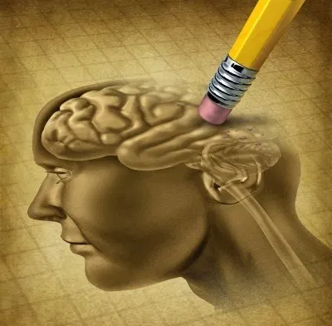
Dementia 101
Understanding the basics of dementia as it impacts adults with ID.
NTG Education & Training Curriculum on Dementia and ID. Copyright 2014. All rights reserved.
53

Slide 54
4 Most Important
Facts About Dementia
  A loss of cognitive (thought) function severe enough to interfere with daily functioning.”
  The term “dementia” describes a group of symptoms.
      It is not a specific disease!
      “The doctor said my son has dementia…thank goodness he doesn’t have Alzheimer’s!”
  The condition we refer to as dementia may be caused by many things.
      Some may be treatable (Ex. Dehydration, B12 deficiency)
      Others are irreversible (Ex. Alzheimer’s, Vascular, Lewy body).
  Dementia is NOT part of normal aging.
54
NTG Education & Training Curriculum on Dementia and ID. Copyright 2014. All rights reserved.
Notes:
Loss of cognitive function can include problems with memory, thinking, and reasoning
54

Slide 55
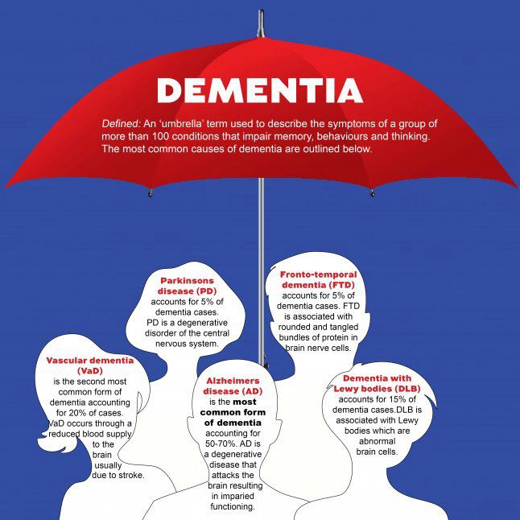
Irreversible Dementias
The symptoms we call “dementia” can have many different causes.
Alzheimer’s disease is the most common.
Image: Dementia Forward
55
NTG Education & Training Curriculum on Dementia and ID. Copyright 2014. All rights reserved.
Notes:
There are many conditions that cause the symptoms that we call “dementia.” This graphic illustrates that the term “dementia” is an umbrella term. The most common form of irreversible dementia is Alzheimer’s disease. Other common forms are Lewy body, Vascular dementia, Parkinson’s disease and Fronto-temporal dementia.
55

Slide 56

Risk of Dementia in ID
Most adults with ID are typically at no more risk than the general population.
Exception: Adults with Down syndrome are at increased risk!
    Younger (40’s and ‘50’s)
    More rapid progression.
NTG Education & Training Curriculum on Dementia and ID. Copyright 2014. All rights reserved.
56
Notes:
Dementia robs an individual of his or her mind, capability to be independent, and often his or her dignity.
Compared to the rates for the general population , the rates for people with DS are roughly 5 times higher.
56

Slide 57
Dementia Prevalence: ID vs. DS
Intellectual Disability
Down Syndrome
Age | Percentage
40+ | 3%
60+ | 6%
80+ | 12%
Age | Percentage
40+ | 22%
60+ | 56%
Matthew P. Janicki and Arthur J. Dalton (2000) Prevalence of Dementia and Impact on Intellectual Disability Services. Mental Retardation: June 2000, Vol. 38, No. 3, pp. 276-288.
NTG Education & Training Curriculum on Dementia and ID. Copyright 2014. All rights reserved.
57

Slide 58
Prevalence of Dementia and Impact on Intellectual Disability Services.
Matthew P. Janicki and Arthur J. Dalton (2000) Prevalence of Dementia and Impact on Intellectual Disability Services. Mental Retardation: June 2000, Vol. 38, No. 3, pp. 276-288.
Increased lifespan = Increase in dementia.
What this means for programs:
  Need to raise the “index of suspicion” among staff and families,
  Programs and services need to become “dementia capable,”
  Need to improve:
    Diagnostic and technical resources,
    Care management supports (to prolong the “aging in place” of adults affected by dementia).
NTG Education & Training Curriculum on Dementia and ID. Copyright 2014. All rights reserved.
58

Slide 59
            Warning Signs
            These problems must be notable and usually occur in a cluster
Dementia is a group of behavior and function change symptoms caused by different conditions or diseases.
Unexpected Memory Loss
Difficulty Doing Usual Tasks
Getting Lost or Misdirected
Confusion in Familiar Situations
Personality Changes
Problems with Gait or Walking
Onset of New Seizures
NTG Education & Training Curriculum on Dementia and ID. Copyright 2014. All rights reserved.
59

Slide 60

Community Care Needs of Adults with ID and Dementia
Dementia is a condition that impairs an individual’s ability to self-direct and be left alone.
Thus…independent living will not be an option as the disease progresses.
NTG Education & Training Curriculum on Dementia and ID. Copyright 2014. All rights reserved.
60

Slide 61

Community Care Needs of Adults with ID and Dementia
What will be needed?
    In home supports (to family caregivers and the person)
    Advanced planning for alternative care
    Diagnostic, medical and behavioral health care
    Support groups for caregivers (family or staff)
    Dementia capable community housing
    Day care programs and respite for family caregivers

Slide 62
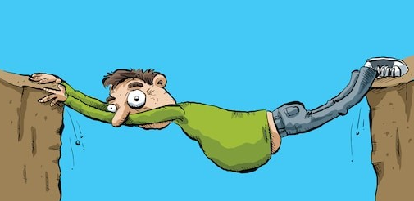
Aging & DD Services…Build a Bridge
Community support provider agencies
  Private/parent based (e.g., Arc chapters)
  Public – state/local government entities
Area Agencies on Aging (AAAs)
  Aging and Disability Resource Centers (ADRCs)
Alzheimer's Association chapters
  Other local dementia care groups
State and local Protection and Advocacy Networks
Faith-based organizations
Statewide or Community-based Respite/Caregiver Coalitions
NTG Education & Training Curriculum on Dementia and ID. Copyright 2014. All rights reserved.
62
Notes:
62

Slide 63
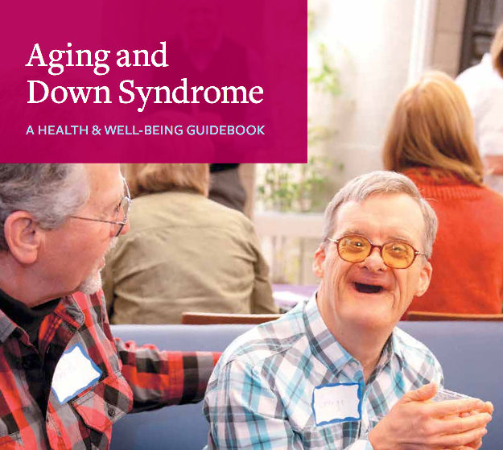
Down Syndrome & Dementia
The unique challenges of dementia in adults with
Down syndrome.
NTG Education & Training Curriculum on Dementia and ID. Copyright 2014. All rights reserved.
63

Slide 64
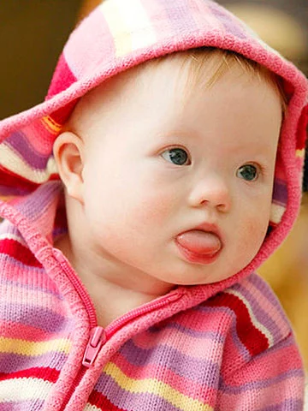
What is Down syndrome (DS)?
First accurate description of a person with DS was published in 1866 by an English physician - John Langdon Down.
DS is a developmental disability – intellectual impairment and physical abnormalities.
DS occurs 1 in 750 live births.
NTG Education & Training Curriculum on Dementia and ID. Copyright 2014. All rights reserved.
64
Notes:
Genetic, older parent correlation
Shorter lifespan:
Life expectancy in 1930s affected by high death rate at birth or early infancy
Life Expectancy in the 1970s increased due to availability of antibiotics, better medical care and conditions, and change in attitude of providing care for children with conditions such as Down syndrome
64

Slide 65
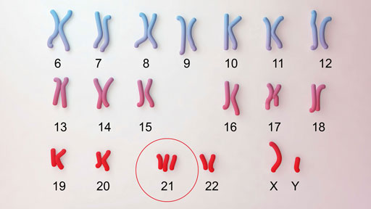
What is Down syndrome (DS)?
DS is caused by a genetic abnormality – an extra full or partial copy of chromosome 21 (Trisomy 21).
Extra copy of genetic material alters the course of development and causes the characteristics associated with Down syndrome.
common physical traits of Down syndrome are:
  low muscle tone, small stature,
  an upward slant to the eyes,
  and a single deep crease across the center of the palm
  each person with Down syndrome is a unique individual and may possess these characteristics to different degrees, or not at all

Slide 66
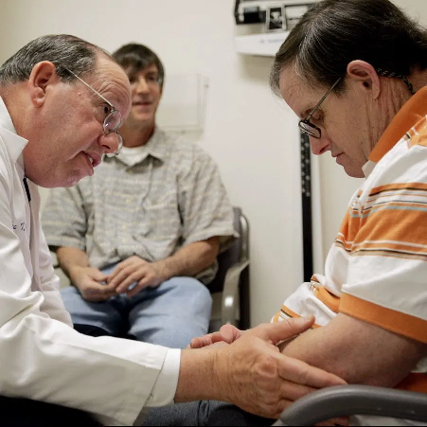
Premature Aging in Down Syndrome
Life expectancy has continued to increase for people with Down syndrome.
Aging increases risk for physical and cognitive changes for people with DS.
NTG Education & Training Curriculum on Dementia and ID. Copyright 2014. All rights reserved.
66
Notes:
Life expectancy in 1930s affected by high death rate at birth or early infancy
Life Expectancy in the 1970s increased due to availability of antibiotics, better medical care and conditions, and change in attitude of providing care for children with conditions such as Down syndrome
66

Slide 67
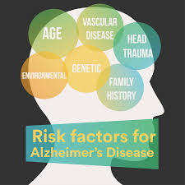
Premature Aging in Down Syndrome
Many individuals with DS age prematurely (age in their 50s).
Adults with DS are at risk for diseases and changes about 20 years earlier than the general population.

Slide 68
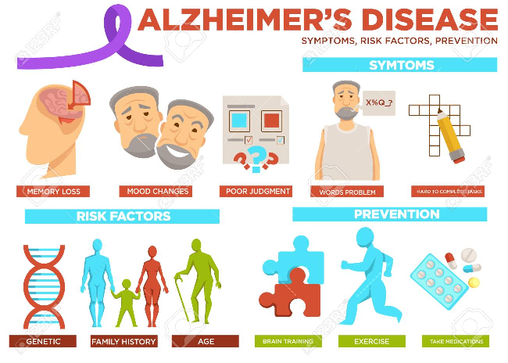
Why a focus on DS?
Down syndrome is one of the most significant risk factors for Alzheimer’s disease.
      Over age 40 - approximately 25% will show clinical signs of dementia.
      Over age 60 - approximately 60% will show clinical signs of dementia
NTG Education & Training Curriculum on Dementia and ID. Copyright 2014. All rights reserved.
68
Notes:
Many adults with Down will show signs of dementia in older age and will need special services.
Source?
68

Slide 69
Adults with DS have specific risk factors for developing “dementia.”
Hearing & visual impairment
Vitamin B12 deficiency
Dehydration
Side Effects of Medications
Depression
Stroke
Seizures
NTG Education & Training Curriculum on Dementia and ID. Copyright 2014. All rights reserved.
69
Notes:
There are specific risk factors for adults with Down syndrome that may appear as symptoms similar to Alzheimer’s dementia resulting in an increased risk for misdiagnosis and assumption of Alzheimer’s dementia. The list on this slide is just a few of the specific risks that may appear to be AD.
69

Slide 70
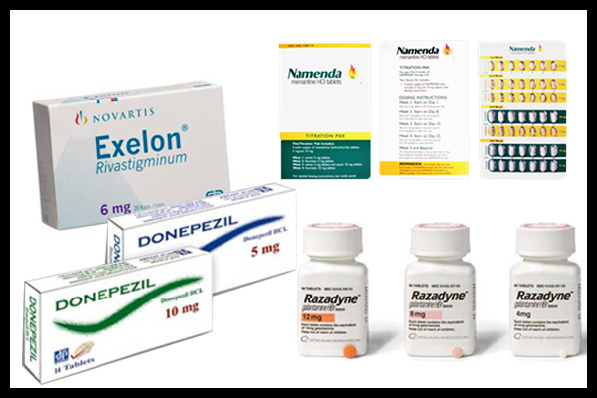
Atypical Presentation of
Alzheimer’s in DS
Earlier onset than general population (> 40).
Management similar to general population.
No strong evidence that Alzheimer’s drugs benefit.
Depression and thyroid disease common in DS and can mimic dementia.

Slide 71
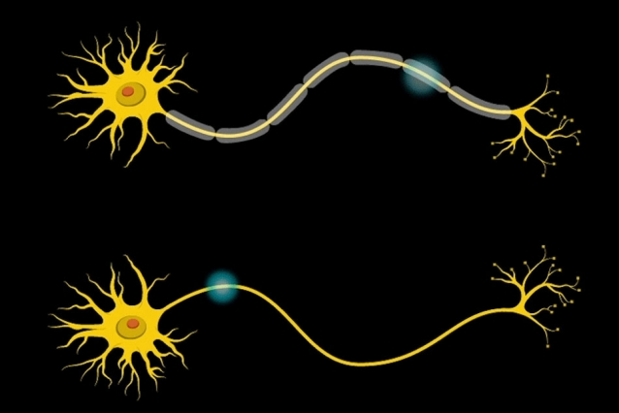
Atypical Presentation of
Alzheimer’s in DS
Normal age-associated deficits are common.
Often present with behavioral symptoms instead of memory loss.
Seizures, myoclonus (sudden, involuntary muscle contractions or relaxation)
NTG Education & Training Curriculum on Dementia and ID. Copyright 2014. All rights reserved.
71

Slide 72

Diagnosing Dementia
The differential diagnosis
NTG Education & Training Curriculum on Dementia and ID. Copyright 2014. All rights reserved.
72

Slide 73
Typical Aging: | Symptoms of Dementia:
Complains about memory loss but able to provide detailed examples of forgetfulness | May complain of memory loss only if asked; unable to recall specific instances
Occasionally searches for words | Frequent word-finding pauses, substitutions
May have to pause to remember directions, but doesn't get lost in familiar places | Gets lost in familiar places and takes excessive time to return home
Remembers recent important events; conversations are not impaired | Notable decline in memory for recent events and ability to converse
Interpersonal social skills are at the same level as they've always been | Loss of interest in social activities; may behave in socially inappropriate ways
Normal
Age-Related Memory Changes
vs.
Dementia
Adapted from: The American Medical Association
NTG Education & Training Curriculum on Dementia and ID. Copyright 2014. All rights reserved.
73
Notes:
73

Slide 74

Diagnostic Overshadowing
The tendency for clinicians to attribute symptoms or a change in behaviors of a person with ID to their underlying cognitive deficits and therefore under-diagnose the presence of co-occurring disease such as dementia.
NTG Education & Training Curriculum on Dementia and ID. Copyright 2014. All rights reserved.
74

Slide 75
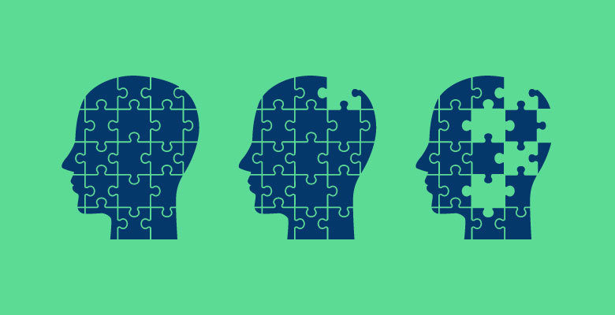
Stages of Dementia
Understanding the progression of dementia.
NTG Education & Training Curriculum on Dementia and ID. Copyright 2014. All rights reserved.
75

Slide 76
Stages
A “yardstick” or estimate.
General measure of the progress of a person's cognitive decline.
Used to determine appropriate supports and accommodations based on the individuals needs and remaining abilities.
The staging model is the generally accepted practice among dementia services.
NTG Education & Training Curriculum on Dementia and ID. Copyright 2014. All rights reserved.
76

Slide 77
How Dementia Progresses
Early Stage – short term memory loss, repetitive questions, etc.
Late-Stage – fully dependent in ADL’s, swallowing problems, incontinence
No Problems – normal level of functioning (for the person)
Mid-Stage – impaired ADL ability, behavioral and psychiatric symptoms, sleep changes
NTG Education & Training Curriculum on Dementia and ID. Copyright 2014. All rights reserved.
77
Notes:
No problems: Normal functioning.
Early stage:
Mild memory problems for recent events.
Mild problems with word and name retrieval.
Starting to have difficulty with complex tasks.
Repeat questions.
Mood and personality changes.
Increased supervision.
Mid Stage
Increased memory loss and confusion.
Trouble completing multi-stage tasks.
Sleep-wake cycle disrupted.
Disorientated to time and place.
Poor judgment.
Difficulty with ADL’s.
Wandering.
Impulsive behavior.
Safety issues emerge.
Unsafe to be left unsupervised.
Late Stage
Inability to communicate.
Swallowing problems.
Incontinence.
Increased sleeping.
Weight loss.
May be bedridden.
Total assistance with ADL’s.
77

Slide 78

How Dementia Impacts Ability to Function
Or…why do people with dementia do the things they do?
NTG Education & Training Curriculum on Dementia and ID. Copyright 2014. All rights reserved.
78

Slide 79
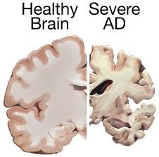
The Damage That Occurs in the Brain
NTG Education & Training Curriculum on Dementia and ID. Copyright 2014. All rights reserved.
79

Slide 80
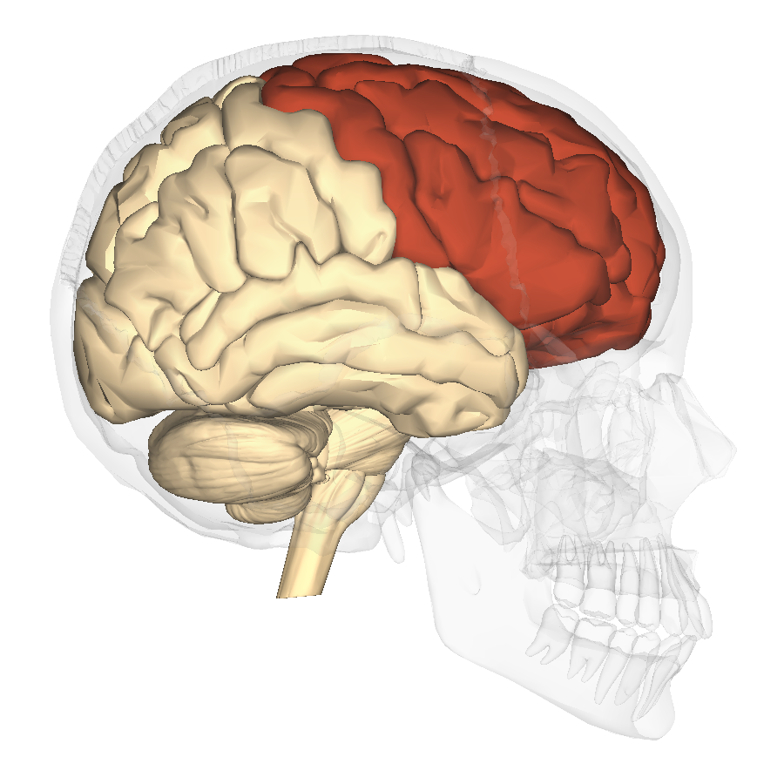
Executive Function
Functions of the frontal lobe.
Judgment
Decision Making
Emotional Control
Task Sequencing
Initiative
Working Memory
Problem Solving
Reasoning
NTG Education & Training Curriculum on Dementia and ID. Copyright 2014. All rights reserved.
80

Slide 81
The 7 A’s
Each A relates to a part of the brain.
Amnesia | Initially short term memory, eventually even long term memory.
Agnosia | Can no longer recognize things using your senses. Unable to recognize faces or familiar objects. May not be able to understand what you see or hear.
Aphasia | Loss of ability to speak, understand, read or write. Can lead to withdrawal or misunderstandings.
Apraxia | Loss of the ability to tell your body how to carry out purposeful movement.
Altered Perception | Misinterpreting the information your senses give you.
Anosognosia | Inability to understand that something has changed and is wrong with you. Unable to see the changes in abilities that others see.
Apathy | Loss of initiative.
NTG Education & Training Curriculum on Dementia and ID. Copyright 2014. All rights reserved.
81

Slide 82


Slide 83

PAIR OF DIMES SHIFT
Paradigm Shift
an important change that happens when the usual way of thinking about or doing something is replaced by a new and different way

Slide 84




Slide 87

Caregiving Strategies by Stage
www.aadmd.org/ntg/curriculum
NTG Education & Training Curriculum on Dementia & ID. Copyright 2014. All rights reserved.
87
Notes:
This session must be connected by trainers to the discussion the day before,, in particular the need for early screening and detection as well as health care advocacy.
87

Slide 88
Review: Regardless of stage, the goals of caring for an individual with dementia are:
Protect the person from physical injury.
Maintain independence as long as possible.
Focus on what the person can still do.
Provide physical and mental activities that the person can do.
Support the person’s dignity and self-esteem at all times.
NTG Education & Training Curriculum on Dementia & ID. Copyright 2014. All rights reserved.

Slide 89

Each stage should be considered in the context of the lifetime functioning capacity.
Example:
It is not a loss or change if the person always had difficulties with language, personal care, eating, etc.
89
NTG Education & Training Curriculum on Dementia & ID. Copyright 2014. All rights reserved.

Slide 90
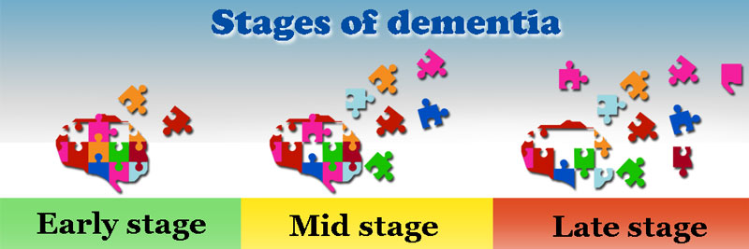

Early Stage Dementia
Changes in function begin to become noticeable.
NTG Education & Training Curriculum on Dementia & ID. Copyright 2014. All rights reserved.
90
Notes:
90

Slide 91
Early Stage Caregiving
Expect noticeable changes in ability to function.
Increasingly forgetful for recent events.
Increasing supervision.
Language difficulties emerge – remembering names, finding the right word.
Trouble with activities requiring complex thought processes:
Finding their way to a new location.
Following directions for new medications.
91

Slide 92
Early Stage Behaviors
Change in previously observed behaviors or personality traits…
  Apathy
  Lack of pleasure
  Withdrawal from activities previously enjoyed
  Irritable, easily upset, volatile emotions, suspicious, paranoid
  Decreased verbalizations, loss of language skills
NTG Education & Training Curriculum on Dementia & ID. Copyright 2014. All rights reserved.
92
Notes:
It should always be emphasized that the behaviors are those that have increased in frequency, duration, intensity, or different than lifelong behaviors for detection of the disease process of dementia
92

Slide 93
Early Stage Care Management
Encourage independence but be aware that…
  Agitation and anxiety may arise in new situations.
  Large tasks will need to be broken down into smaller pieces.
  Written reminders may be helpful.
  Hazardous activities should be supervised.
  May need reminders for personal care.
  Establishing and maintaining a regular routine is crucial.
NTG Education & Training Curriculum on Dementia & ID. Copyright 2014. All rights reserved.
93
Notes:
The goal is to maintain function and involvement in activity, not to increase skills or new learning.
Safety and ease of movement for the caregiver and the adult with AD.
Increase use of visual cues such as pictures or direct observation
93

Slide 94
Health and Wellness
Remains a Focus
Maintain:
  Movement and activity level as much as possible.
  Optimum hydration and nutrition.
Continual monitoring for co-occurring chronic conditions.
Sudden change in behavior are usually a result of delirium due to:
  Acute illness
  Pain or discomfort such as constipation
  Infections such as urinary tract or upper respiratory
NTG Education & Training Curriculum on Dementia & ID. Copyright 2014. All rights reserved.
94

Slide 95
Mid-Stage Dementia
NTG Education & Training Curriculum on Dementia & ID. Copyright 2014. All rights reserved.
95

Slide 96
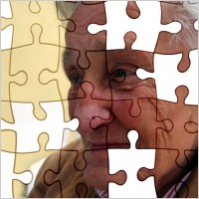
Significant Impairment in all Areas
Increasingly frail
Increasingly dependent
NTG Education & Training Curriculum on Dementia & ID. Copyright 2014. All rights reserved.
96

Slide 97

The World has become a confusing and threatening place.
NTG Education & Training Curriculum on Dementia & ID. Copyright 2014. All rights reserved.
97
Notes:
Confusion = Discomfort = Behavior
Middle-stage is usually when the most difficult behaviors begin to arise.
Angry, agitated, combative.
Verbal outbursts
Hoarding, rummaging
Paranoia, suspiciousness, accusations
Sundowning
Wandering
Problems with personal care – esp. bathing
Eating difficulties, possibly swallowing
Incontinence
97

Slide 98

Easily Upset
Over stimulation
Fatigue
Pain, physical discomfort or illness
Change in routine or environment
Caregiver expecting too much
NTG Education & Training Curriculum on Dementia & ID. Copyright 2014. All rights reserved.
98

Slide 99
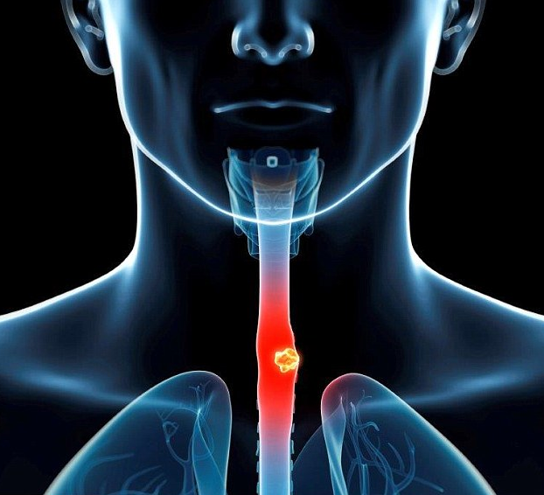
Body Functions Change
The middle-stage is a time when bodily functions also may become impaired.
Incontinence
Swallowing
Sleep-wake cycle
NTG Education & Training Curriculum on Dementia & ID. Copyright 2014. All rights reserved.
99

Slide 100
Increasing Impairments
Increasing Supervision
Routine comfort = safety and control = fewer behaviors.
Fewer steps to activities and tasks
  Adapt…but don’t take them away!
    Early stage – can make a sandwich unassisted.
    Now…set out sandwich ingredients, cue the person when they become confused or distracted.
Offer choice but limit…
    Would you like to wear the red shirt or the blue shirt?
    Would you like a peanut butter or ham and cheese sandwich for lunch?
Rely on visual cues instead of written.
NTG Education & Training Curriculum on Dementia & ID. Copyright 2014. All rights reserved.
100

Slide 101
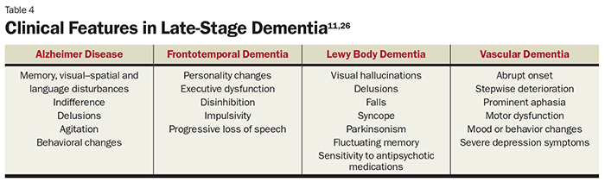
Clinical Features of
Various Dementias
Although the brain neuropathy will differ, caregivers need to note the nature of the behaviors exhibited.
NTG Education & Training Curriculum on Dementia and ID. Copyright 2014. All rights reserved.
101
Notes:
http://nurse-practitioners-and-physician-assistants.advanceweb.com/Continuing-Education/CE-Articles/End-Stage-Dementia.aspx
101

Slide 102
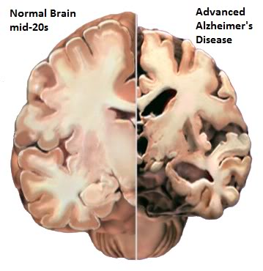
Why is it Important or Useful to Know Type of Dementia?
Different types of dementia have different characteristics. It can be helpful to know that particular behaviors are part of the disease process and not bad behavior.
Lewy body – visual hallucinations
Fronto-temporal – profound personality change, disinhibition
The type of dementia may impact what medications are used.
Lewy body – sensitivity to certain antipsychotics.
Fronto-temporal – does not respond to common Alzheimer’s medications such as Aricept.
Ensure that treatable causes of the symptoms have been ruled out.
NTG Education & Training Curriculum on Dementia and ID. Copyright 2014. All rights reserved.
102
Notes:
102

Slide 103
Common Conditions to Rule Out through Differential Diagnosis.
  Stroke
  Side effects of medications 
  Nutritional deficits and imbalances
  Alcohol and drug abuse
  Hypothyroidism
  Dehydration, malnutrition
  Cardiovascular disease
  Environmental challenges
  Sensory impairments
  Depression
  Lyme disease
  Normal pressure hydrocephalus
  Sleep apnea
NTG Education & Training Curriculum on Dementia and ID. Copyright 2014. All rights reserved.
103
Notes:
There are many causes to changes and decline in functioning in older people with ID besides dementia related causes. For older people in the general population diagnosis can be challenging as there is often more than one cause to the change in behavior or decline in functioning. As older adults with ID may have challenges in communication and cognitive capacity prior to the recent symptoms the diagnosis is more complex. The changes can be attributed to many underlying causes and each one needs to be ruled out and appropriate treatment provided if possible. Because of the complexity of diagnosis and the risk for diagnostic overshadowing in adults with ID it is essential that a differential diagnosis is conducted as part of the diagnostic process.
★ Ex. Ditropan has an anticholinergic effect that can increase confusion.
103

Slide 104
The Three D’s
Dementia
Delirium
Depression
Gradual over months to years
Sudden onset, hours to days
Recent unexplained change in mood that lasts for over 2 weeks
NTG Education & Training Curriculum on Dementia and ID. Copyright 2014. All rights reserved.
104
Notes:
Reduced sensory perception
Hearing – refuse to participate in activities, inappropriate response to questions, confusion in noisy situations
Vision – unable to recognize familiar people, disorientation
Menopause – memory impairment
Multiple medications - confusion
Delirium – sudden behavioral change which may fluctuate as the day progresses.
Depression – lethargy, change in appetite or sleep, unnecessary worry over trivial issues.
104

Slide 105
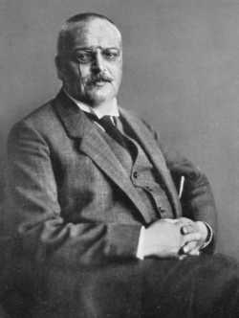
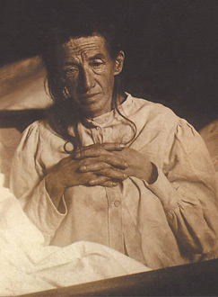
Alzheimer’s disease
The most common form of dementia.
Presents differently in Down syndrome.
NTG Education & Training Curriculum on Dementia and ID. Copyright 2014. All rights reserved.
105

Slide 106
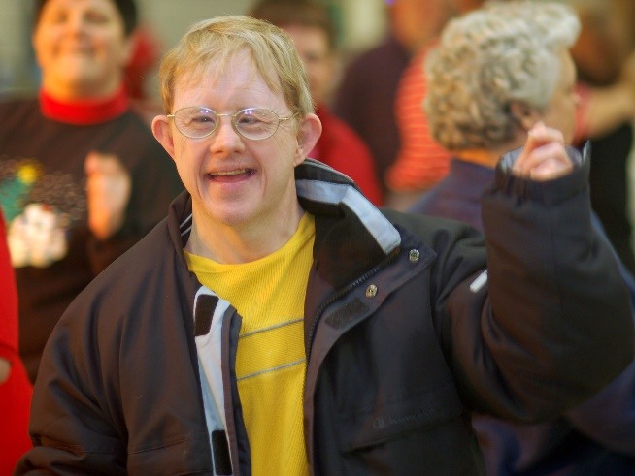
Why a Focus on Alzheimer’s?
Alzheimer’s often presents differently in people
with Down syndrome.
  Abrupt onset of seizure activity when there had been none in the past.
  Incontinence when an individual has always been independent in toileting.
  Short- term memory loss may depend upon the previous level of memory demands and reliance on memory in everyday life.
  Sleep/wake cycle disruptions.
*Just as in the general population, the course and symptom presentation is unpredictable and unique to the individual.
NTG Education & Training Curriculum on Dementia and ID. Copyright 2014. All rights reserved.
106
Notes:
A significant warning sign of dementia is if an individual with Down syndrome is experiencing seizures for the first time in their life (British Psychological Society,
2009).
It has also been reported that Alzheimer’s disease in Down’s syndrome presents with a greater prevalence of low mood, excessive overactivity/restlessness, disturbed sleep, excessive uncooperativeness and auditory hallucinations (Cooper & Prasher, 1998).
Temple and Konstantareas found that persons with DS and AD have less severe psychotic behaviors, fewer hallucinations, and fewer delusions and were more likely to engage in physical movements than those with AD only. (Temple V, Konstantareas MM. A comparison of the behavioural and emotional characteristics of Alzheimer's dementia in individuals with and without Down syndrome. Can J Aging. Summer 2005;24(2):179-89. )
For more information: http://www.alzheimer.ca/~/media/Files/national/Other-dementias/research_Down_syndrome_2010_e.pdf
106

Slide 107

Alzheimer’s disease
Most common form of dementia.
Gradual onset.
Short term memory.
Generalized brain atrophy.
  Shrinks by 30% by time of death.
Amyloid plaques and neurofibrillary tangles.
NTG Education & Training Curriculum on Dementia and ID. Copyright 2014. All rights reserved.
107
Notes:
Two abnormal structures called plaques and tangles are prime suspects in damaging and killing nerve cells.
Plaques are deposits of a protein fragment called beta-amyloid (BAY-tuh AM-uh-loyd) that build up in the spaces between nerve cells.
Tangles are twisted fibers of another protein called tau (rhymes with “wow”) that build up inside cells.
Though most people develop some plaques and tangles as they age, those with Alzheimer's tend to develop far more. They also tend to develop them in a predictable pattern, beginning in areas important for memory before spreading to other regions.
Scientists do not know exactly what role plaques and tangles play in Alzheimer's disease. Most experts believe they somehow play a critical role in blocking communication among nerve cells and disrupting processes that cells need to survive.
It's the destruction and death of nerve cells that causes memory failure, personality changes, problems carrying out daily activities and other symptoms of Alzheimer's disease.
107

Slide 108

What Causes Alzheimer’s?
Exact cause still unknown.
Damage begins 10 – 20 years before symptoms begin to show!
It is likely that the cause of
Alzheimer’s includes some
mix of genetic, environmental,
and lifestyle factors.
NTG Education & Training Curriculum on Dementia and ID. Copyright 2014. All rights reserved.
108
Notes:
www.nia.nih.gov/alzheimers/publication/alzheimers-disease-fact-sheet#causes
108

Slide 109
Continued
Most people with Alzheimer’s disease have “late-onset” Alzheimer’s.
  After age 65.
Early-onset Alzheimer’s is a rare form of the disease.
  Age 30 to 60
  Less than 5 percent of all people who have Alzheimer’s disease.
Individuals with Down syndrome develop Alzheimer’s at a younger age than the general population.
NTG Education & Training Curriculum on Dementia and ID. Copyright 2014. All rights reserved.
109
Notes:
www.nia.nih.gov/alzheimers/publication/alzheimers-disease-fact-sheet#causes
109

Slide 110
Mild Cognitive Impairment (MCI)
Memory problems greater than those expected for age.
Do not experience the personality changes or other problems that are characteristic of AD.
Serious enough to be noticed by the individuals experiencing them or to other people…but not severe enough to interfere with ability to function in daily life.
Because the changes caused by MCI are not severe enough to affect daily life, a person with MCI does not meet diagnostic guidelines for dementia.
NTG Education & Training Curriculum on Dementia and ID. Copyright 2014. All rights reserved.
110
Notes:
Mild cognitive impairment (MCI) is an intermediate stage between the expected cognitive decline of normal aging and the more serious decline of dementia. It can involve problems with memory, language, thinking and judgment that are greater than normal age-related changes.
Mild cognitive impairment is a "clinical" diagnosis representing a doctor's best professional judgment about the reason for a person's symptoms. There are currently no tests or procedures to demonstrate conclusively that a person has MCI. It's also not yet possible to determine the underlying cause of MCI in a specific person.
The risk factors most strongly linked to MCI are the same as those for dementia: advancing age, family history of Alzheimer's or another dementia, and conditions that raise risk for cardiovascular disease.
110

Slide 111


Slide 112

A Taste of What it Might be Like
From Sympathy to Empathy

