Slide 1
The Role of the
DSP as a Medical Escort
2019 DD/ID Workshop
Rick Rader, MD

Slide 2
Aspirations for Individuals with ID/DD

Slide 3
Aspirations for Individuals with ID/DD

Slide 4
Aspirations for Individuals with ID/DD
Human Connections & Family Life

Slide 5
Aspirations for Individuals with ID/DD
Relationships

Slide 6
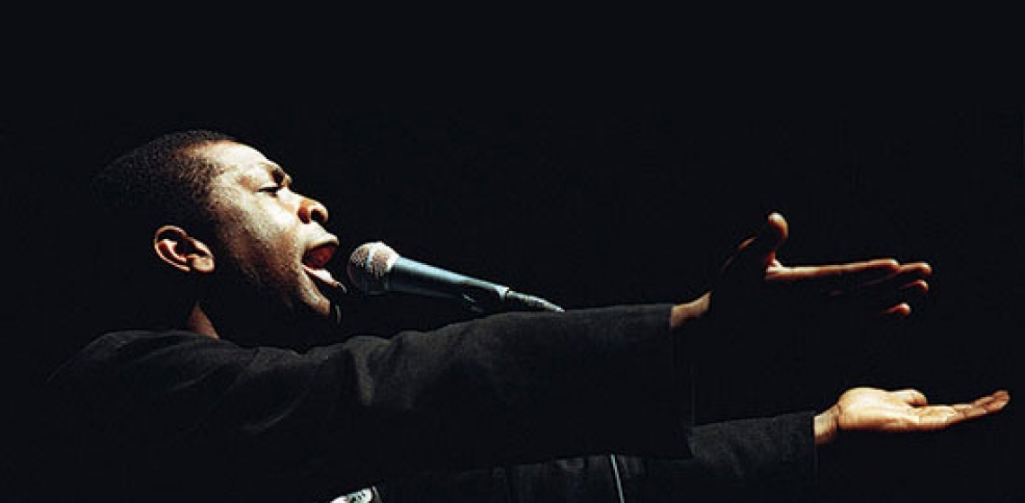
Aspirations for Individuals with ID/DD
Opportunities to Express Yourself
with Music, Art, etc.

Slide 7
Aspirations for Individuals with ID/DD
Community Participation

Slide 8
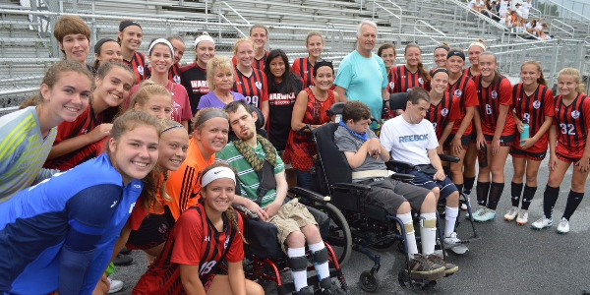
Aspirations for Individuals with ID/DD
Meaningful Day

Slide 9
Aspirations for Individuals with ID/DD
Opportunities for New Experiences

Slide 10
Aspirations for Individuals with ID/DD
To Exercise Their Spirituality

Slide 11
Aspirations for Individuals with ID/DD
Hobbies, Interests and Learning

Slide 12
Aspirations for Individuals with ID/DD
To Feel Valued & Needed

Slide 13
Aspirations for Individuals with ID/DD
Rewarding Jobs

Slide 14
Aspirations for Individuals with ID/DD
Home Ownership

Slide 15
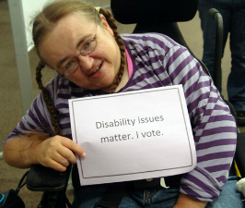
Aspirations for Individuals with ID/DD
Voting

Slide 16
Aspirations for Individuals with ID/DD
Recreation, Leisure, & Sports

Slide 17
Aspirations for Individuals with ID/DD
Retirement

Slide 18
Aspirations for Individuals with ID/DD
Vacations & Travel

Slide 19
Aspirations for Individuals with ID/DD
Energy and Stamina To Do It All

Slide 20
Aspirations for Individuals with ID/DD
SELF DETERMINATION
JOY
HUMAN CONNECTIONS & FAMILY LIFE
RELATIONSHIPS
OPPORTUNITIES TO EXPRESS YOURSELF, WITH MUSIC & ART
COMMUNITY PARTICIPATION
MEANINGFUL DAY
OPPORTUNITIES FOR NEW EXPERIENCES
TO EXERCISE THEIR SPIRITUALITY
HOBBIES, INTERESTS AND LEARNING
TO FEEL VALUED & NEEDED
REWARDING JOBS
HOME OWNERSHIP
VOTING
RECREATION, LEISURE, SPORTS
RETIREMENT
VACATION & TRAVEL
ENERGY AND STAMINA TO DO IT ALL

Slide 22
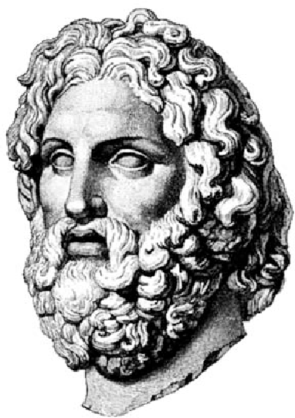
“When health is absent, wisdom cannot reveal itself, art cannot manifest, strength cannot fight, wealth becomes useless, and intelligence cannot be applied.” ― Herophilus

Slide 23
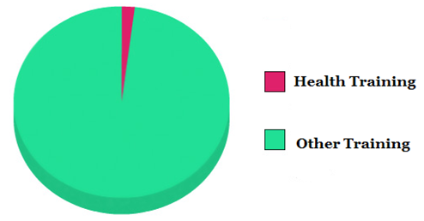
TYPICAL DSP ORIENTATION TRAINING TOPICS
Overview of ID/DD
Agency Rules, Policies and Regulations
History of Institutionalization
People First Language
Human Rights
Person Centered Thinking
Abuse, Neglect and Mistreatment
Incident Reporting
Community Inclusion
Transportation Safety
Communication Styles
Crisis Intervention Strategies
Ethics
Interdisciplinary Team Dynamics
Documentation
Behavioral Support
Confidentiality and Privacy Issues
CPR, First Aid and Seizure Protocols

Slide 24
NO MEDICAL SCHOOL FOR DSP’s
Dr. Brooks Jackson
Dean Univ. of Iowa Medical School

Slide 25
NO MEDICAL SCHOOL FOR DSP’s

Slide 26
WELCOME TO
DR. RADER’S ABBREVIATED,
CONDENSED, NO NONSENSE, JUST WHAT YOU NEED
MEDICAL SCHOOL FOR DSP’s
DSP

Slide 27
HEALTH
What Does It Really Mean

Slide 28
HEALTH
What Does It Really Mean?
“Health is a state of complete physical, mental and social well-being and not merely the absence of disease or infirmity.“
1948

Slide 29
HEALTH
What Does It Really Mean?
“Health is a resource for everyday life, not the objective of living. Health is a positive concept emphasizing social and personal resources, as well as physical capacities.”
1986

Slide 30
HEALTH
What Does It Really Mean?
Health is the ability of a body to adapt to new threats and infirmities
Health is a resource to support an individuals function in wider society.
Current Ideology

Slide 31
HEALTH
What Does It Really Mean?
Physical Health = Body Functions at Peak Performance
Mental Health = Ability to Enjoy Life & Achieve Balance

Slide 32
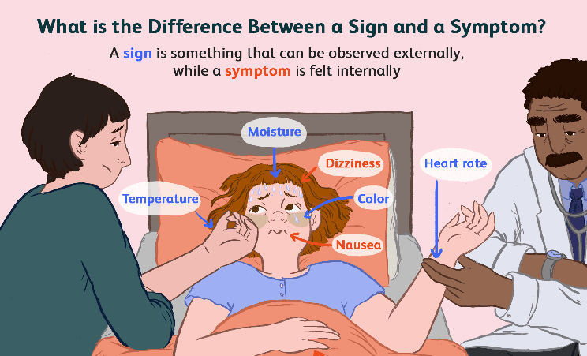
SIGNS & SYMPTOMS

Slide 33
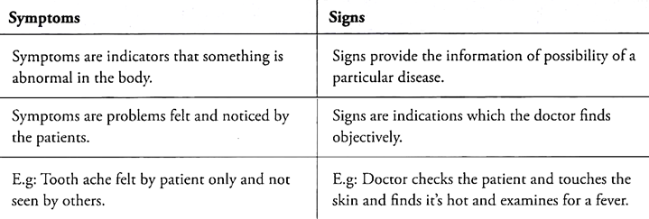
DIFFERENCE BETWEEN SYMPTOMS & SIGNS
OF A DISEASE

Slide 34
WHAT IS A SYNDROME

Slide 35
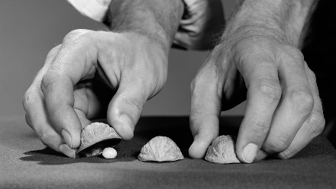

Slide 36
NBA ALL STAR SYNDROME

Slide 37
NBA PLAYERS
TALL
ATHLETIC
AFRICAN AMERICAN
HIGHLY PAID
CELEBRITY STATUS

Slide 38
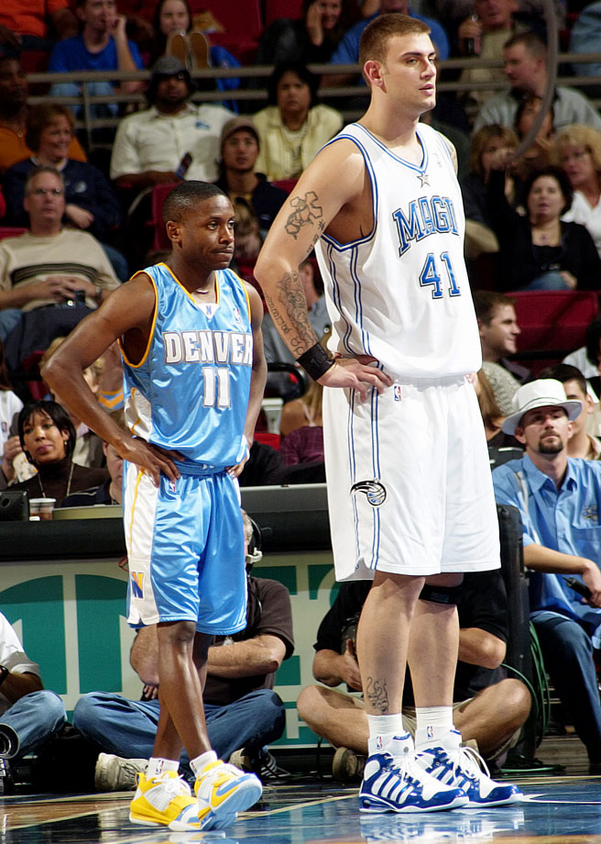
NBA PLAYER
Then along comes a short guy and blows the NBA player criteria (syndrome)

Slide 39
NBA PLAYER
Then along comes a white guy and blows the NBA player criteria (syndrome)

Slide 40
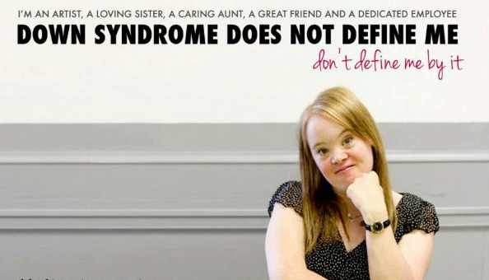

Slide 41
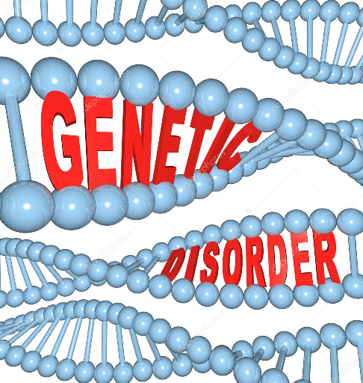
DISEASE TYPES
Genetic Disorder

Slide 42
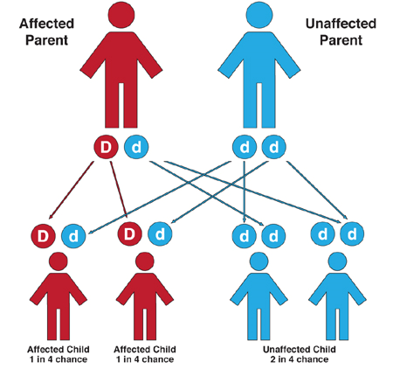
DISEASE TYPES
Inherited Disease

Slide 43
DISEASE TYPES
Environmental Disease

Slide 44
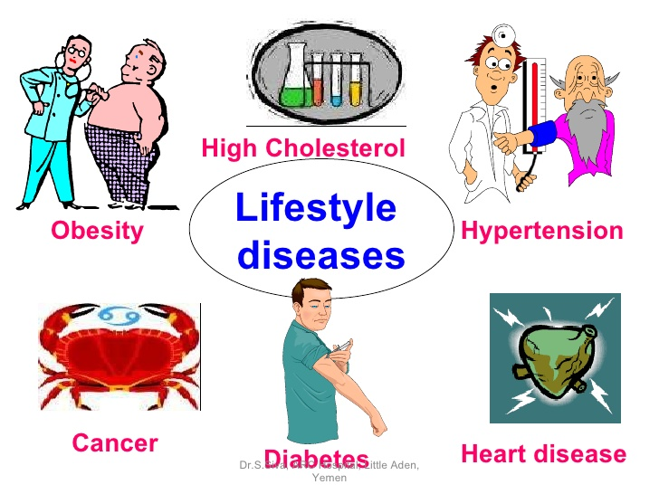
DISEASE TYPES
Lifestyle Diseases

Slide 45
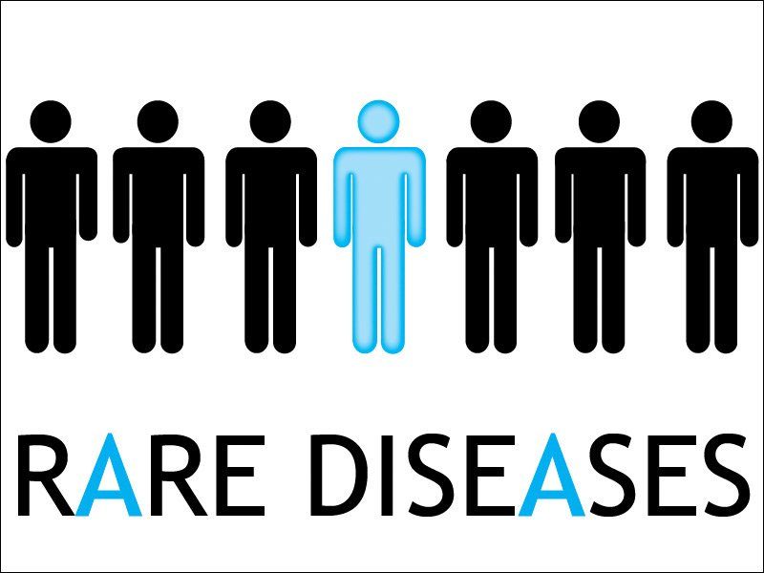
DISEASE TYPES
Rare Diseases

Slide 46
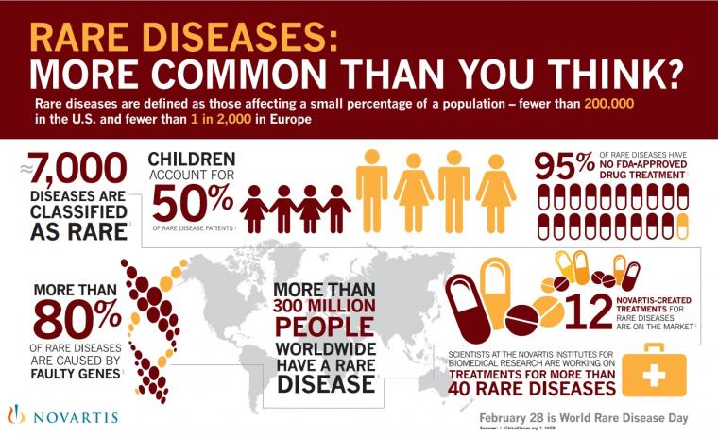
DISEASE TYPES
Rare Diseases

Slide 47
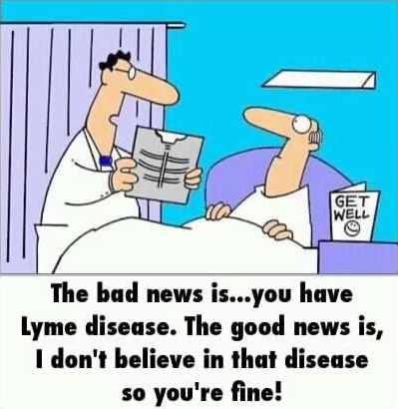

Slide 48
DISEASES COME IN THREE FLAVORS

Slide 49
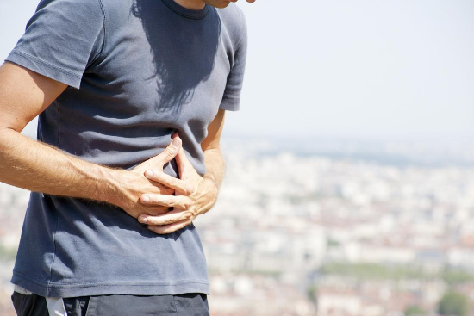
DISEASES COME IN THREE FLAVORS
ACUTE

Slide 50
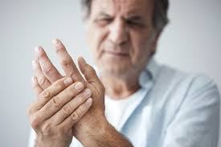
DISEASES COME IN THREE FLAVORS
CHRONIC

Slide 51
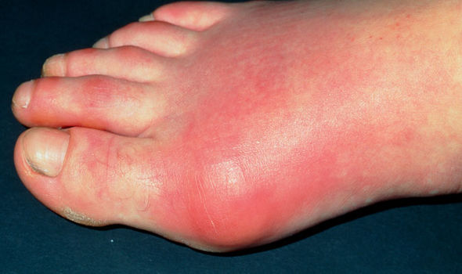
DISEASES COME IN THREE FLAVORS
ACUTE ON CHRONIC

Slide 52
DISEASE PRESENTATIONS
THE EASY, THE NOT SO EASY & THE VIIRTUALLY IMPOSSIBLE
TYPICAL
ATYPICAL

Slide 53
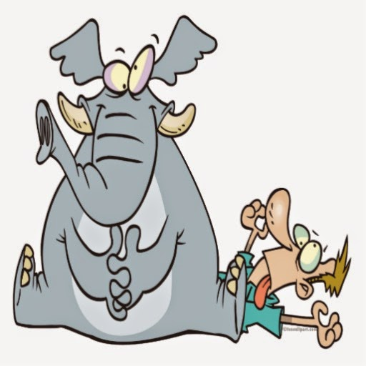
DISEASE PRESENTATIONS
TYPICAL PRESENTATION OF A
TYPICAL CONDITION
"Feels like an elephant is sitting on my chest"
HEART ATTACK

Slide 54
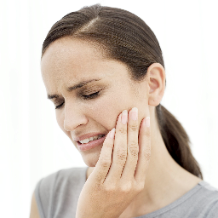
DISEASE PRESENTATIONS
ATYPICAL PRESENTATION OF A
TYPICAL CONDITION
“Suddenly I felt this terrible pain in my jaw”
HEART ATTACK

Slide 55
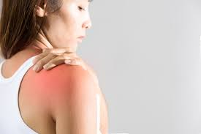
DISEASE PRESENTATIONS
TYPICAL PRESENTATION OF A
ATYPICAL CONDITION
“Geez my right shoulder is killing me”
LIVER DISEASE

Slide 56
DISEASE PRESENTATIONS
ATYPICAL PRESENTATION OF A
ATYPICAL CONDITION
“Seems like every time I take a hot bath my vision is blurry.”
MULTIPLE SCLEROSIS

Slide 57
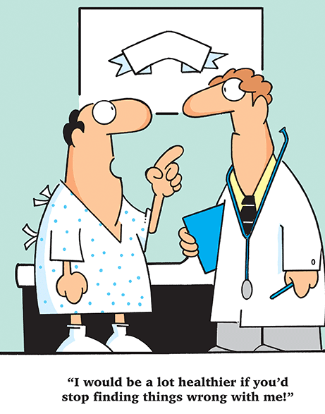

Slide 58
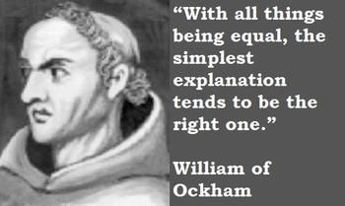

Slide 61
DIAGNOSIS AND TREATMENT: NOT AS SIMPLE AS IT SEEMS
There are 12,420 DIFFERENT DISEASES, CONDITIONS, DISORDERS
There are 1,453 MEDICATIONS TO SELECT FROM
There are 2,180 DIFFERENT TESTS, PROCEDURES AND IMAGES TO EVALUATE

Slide 62
BARRIERS TO CARE

Slide 63
BARRIERS TO CARE
Physician Reluctance

Slide 64
BARRIERS TO CARE
Reimbursement

Slide 65
BARRIERS TO CARE
Time Constraints

Slide 66
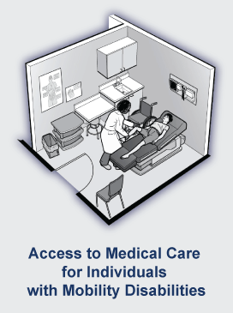
BARRIERS TO CARE
ADA Non Compliance

Slide 67
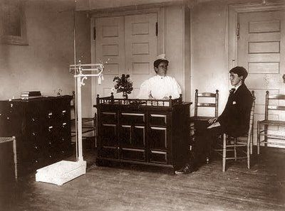
BARRIERS TO CARE
Culture of the Office, Clinic or Practice

Slide 68
BARRIERS TO CARE
Transportation

Slide 69
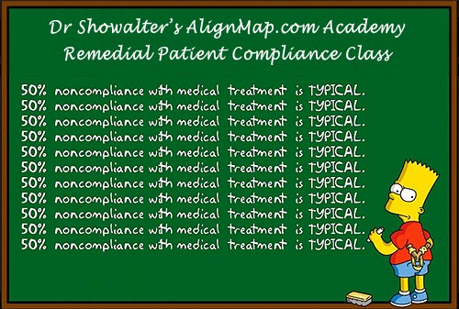
BARRIERS TO CARE
Non Compliant Patients

Slide 70
BARRIERS TO CARE
Staff Indifference

Slide 71
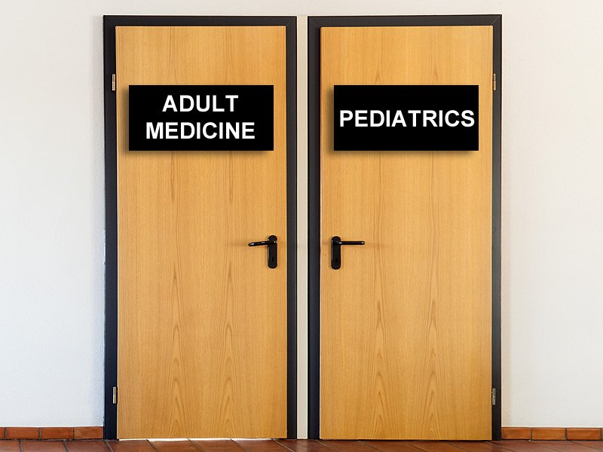
BARRIERS TO CARE
Healthcare Transition

Slide 72
BARRIERS TO CARE
Incomplete & Inaccurate Medical Records

Slide 73
BARRIERS TO CARE
Hiding Behind HIPAA

Slide 74
MYTHBUSTERS

Slide 75
BARRIERS TO CARE
Communicating Pain

Slide 76
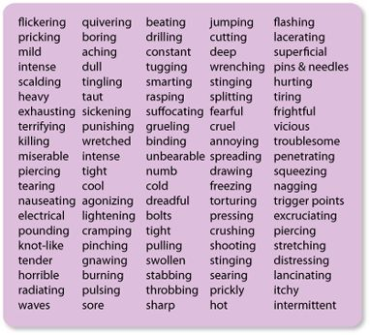
WORDS TO DESCRIBE PAIN
Words that Describe Types of Pain

Slide 77
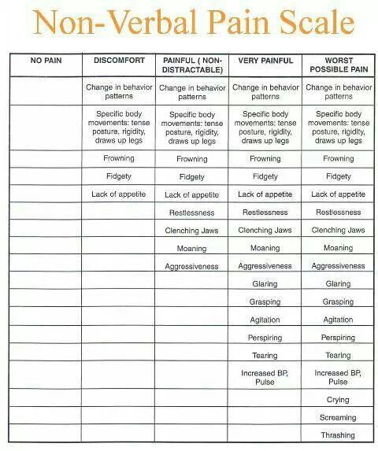
NON VERBAL PAIN SCALE

Slide 78
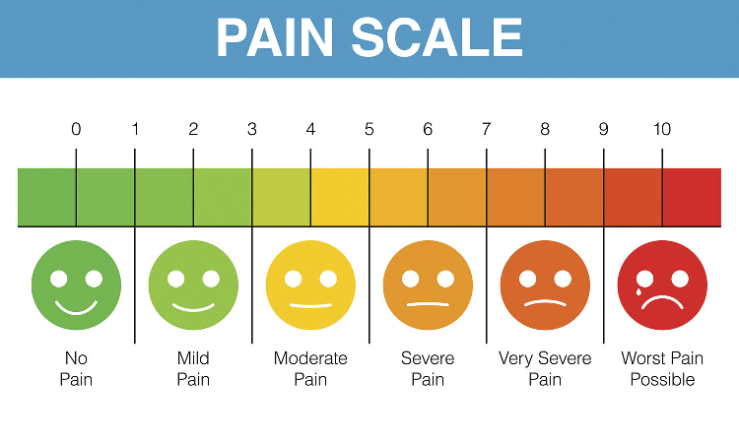

Slide 79
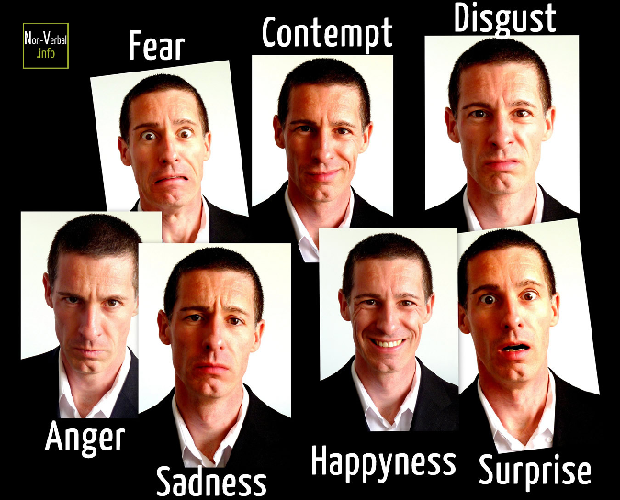
FACIAL EXPRESSIONS

Slide 80
EMOTIONS CHART

Slide 81
BARRIERS TO CARE
Diagnostic Overshadowing

Slide 82
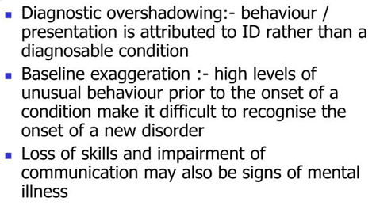
BARRIERS TO CARE
Diagnostic Challenges

Slide 84
FATAL FIVE
“Most prevalent preventable causes of death in people with ID/DD living in the community”

Slide 85
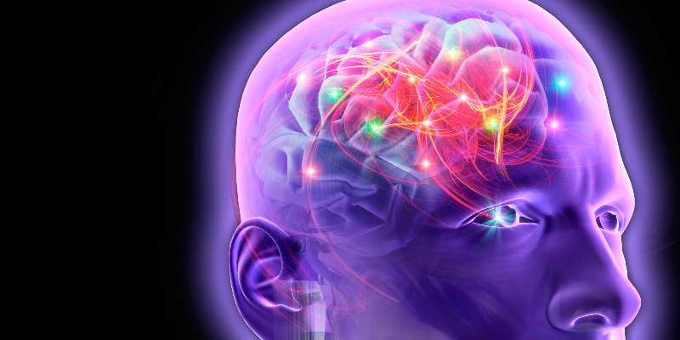
FATAL FIVE
Seizures

Slide 86
FATAL FIVE
Dehydration

Slide 87
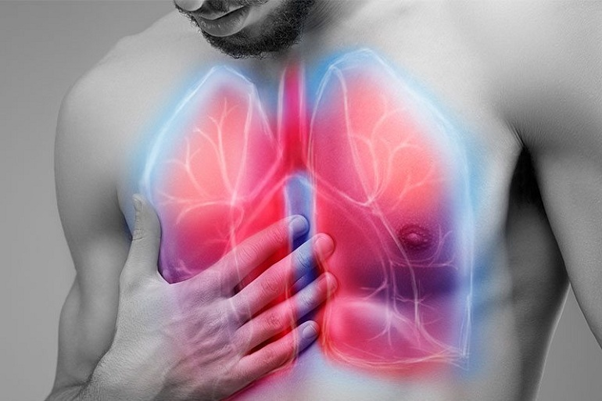
FATAL FIVE
Aspiration

Slide 88
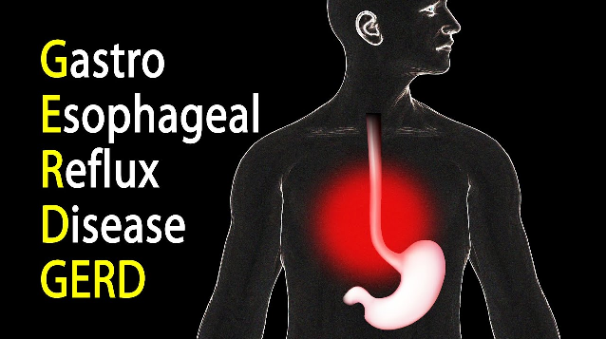
FATAL FIVE
GERD

Slide 89
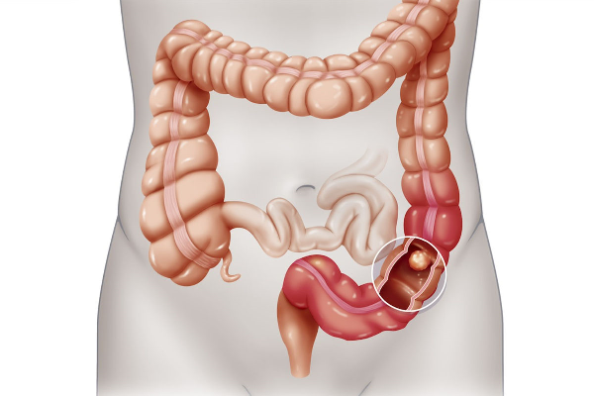
FATAL FIVE
Bowel Obstruction

Slide 90
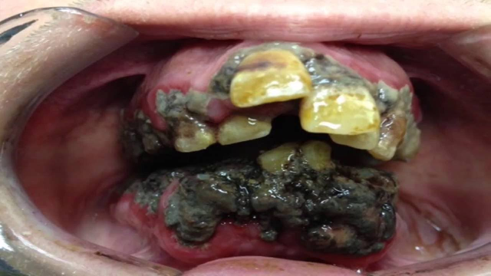
ORAL HEALTH DISGRACE

Slide 91
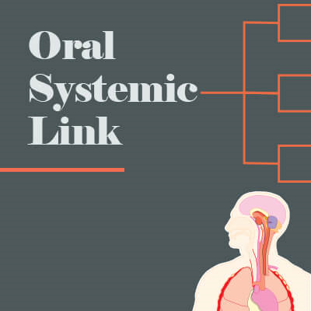
ORAL SYSTEMIC LINK

Slide 92
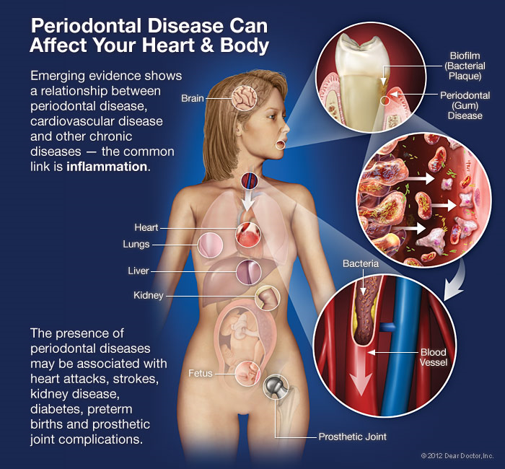
ORAL SYSTEMIC CONNECTION

Slide 93
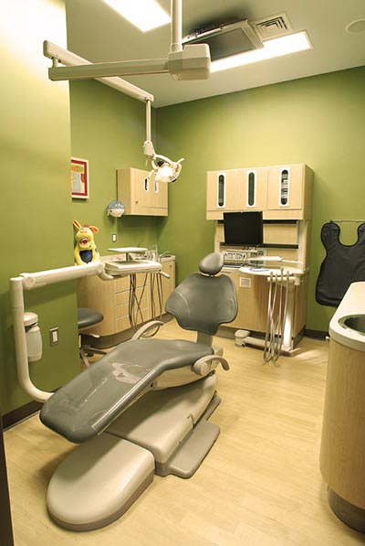
DENTAL CUBICLE

Slide 94
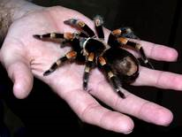
DESENSITIZATION

Slide 95
TELL - SHOW-DO

Slide 96
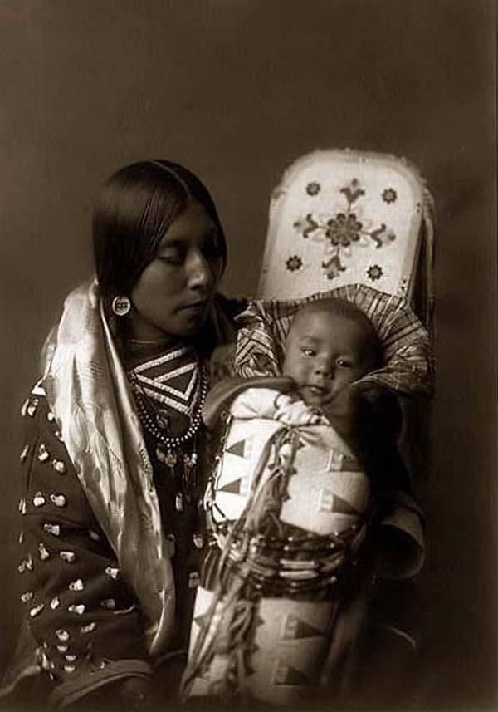
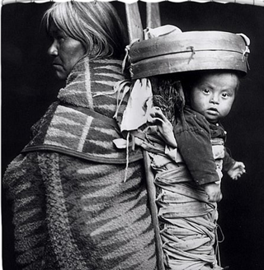
IMMOBILIZATION
&
STABILIZATION

Slide 97
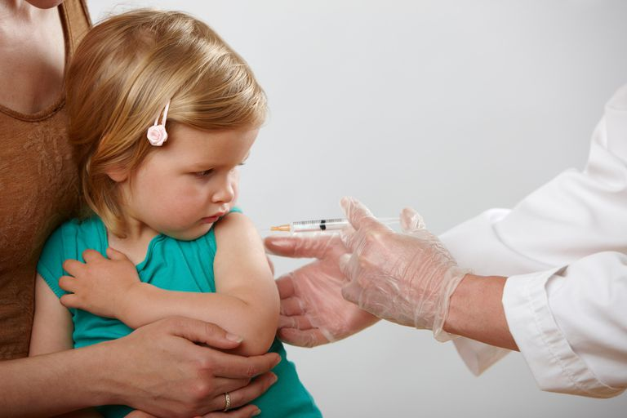
MOM HOLDING
BABY FOR SHOT

Slide 98
PARENTS HOLDING CHILD FOR DENTAL EXAM

Slide 99
HOLDING CHILD IN EMERGENCY ROOM

Slide 100
PAPOOSE BOARD
Immobilization and Stabilization

Slide 101
LAST OPTION

Slide 102
CODA & DENTAL STUDENTS
Starting January 2020 All U.S. Dental Schools will be Required to Teach Students How to Treat Patients with Intellectual and Developmental Disabilities

Slide 103
OUTCOME

Slide 104
ORGAN DONOR CHART

Slide 105
AMELIA RIVERA

Slide 106
CHOP HOSPITAL

Slide 107
CHOP HOSPITAL
“We don’t waste organs on
kids like that”

Slide 108
UPMC
TRANSPLANT CENTER
Opening the door for organs for individuals with intellectual and developmental disabilities

Slide 109
ADVOCATE

Slide 110
BE AN ADVOCATE
Good idea but it’s hardly a walk in the park

Slide 111
AUTHORITY GRADIENT

Slide 112
AUTHORITY GRADIENT
Cockpit Culture

Slide 113
AUTHORITY GRADIENT
MILGRAM EXPERIMENT

Slide 114
MILGRAM EXPERIMENT
“You must increase the shock!”

Slide 116
THE
DSP – DNR DILEMMA
To honor or not to honor…

Slide 117
NADSP E-BADGE
National Alliance for Direct Support Professionals
Health, Wellness and
Safety Competency E-Badge

Slide 118
MOCK VISIT TO EMERGENCY ROOM

Slide 119
TRIP TO OBSERVE EMERGENCY ROOM

Slide 120
In Case You Forgot
Bathroom Break
See You in 10

Slide 121
First A Word About A Word

Slide 123
DSP
Looking at the “P” in DSP

Slide 124
What defines a professional?
Education & Training
Code of Ethics
Accountability
Allegiance
Representation
Recognition

Slide 125
What defines a professional?
Allegiance

Slide 126
What defines a professional?
Representation

Slide 127
DSP’s : Roles & Skills
Teacher
Demonstrator
Trainer
Advocate
Translator
Counselor
Memory Jogger
Decision Navigator

Slide 128
DSP’s : Roles & Skills (cont.)
Reality Checker
Pacer
Prompter
Encourager
Health Promoter
Environmentalist
Questioner
Risk Reducer

Slide 129
DSP’s : Roles & Skills (cont.)
Companion
Consequence Broker
Historian
Behavioral Plan Supporter
Scheduler
Innovator
Protector
Motivator
Empathizer

Slide 130
The DSP as an Escort:
“Where do consequences lead?
Depends on the escort.”
Stanislaw Lem

Slide 131
Today’s Healthcare

Slide 132
Today’s Healthcare:
A Complex Maze
Excessive Reliance on technology
Workforce Shortage
Fragmented Specialization
Poor Care Coordination
Mistakes, Errors & Screw Ups
Expensive
Insurance, Eligibility Confusion
Redundancy
Time Constraints

Slide 133
ER visits are tripled for
adults with ID/DD
Once again
we get the short end of the stick

Slide 134
Difficult patients more likely to be medically misdiagnosed.
Once again
we get the short end of the stick

Slide 135
Lifespan of an individual with
Down Syndrome is 55 yrs.
Lifespan of an African American with
Down Syndrome is 25 yrs.
Once again
we get the short end of the stick

Slide 136
9 out of 10 patients don’t fully
understand or remember what to do after a doctors visit.
Once again
we get the short end of the stick

Slide 137
8 out of 10 patients don’t tell the doctor what they intended to tell them.
Once again
we get the short end of the stick

Slide 138
Nearly half of all patients have
difficulty understanding and acting on
health information
Once again
we get the short end of the stick

Slide 139
The consequences of dysfunctional medical appointments:
Medication Mismanagement
Missed Follow-up Appointments
Missed Referral Appointments
Missed Diagnostic Referrals
Missed Therapy Referrals

Slide 140
The stages of a medical appointment:
Preparation & communication
Arriving at the Doctor’s office
Meet the staff
The office/clinic environment
Encounter with the health provider
Results & recommendations
Adherence to “next steps”

Slide 141
The stages of a medical appointment:
Preparation & communication

Slide 142
The stages of a medical appointment:
Preparation & communication

Slide 143
The stages of a medical appointment:
Preparation & communication

Slide 144
The stages of a medical appointment:
Arriving at the Office
Anticipate any and ALL receptions

Slide 145
The stages of a medical appointment:
Preparation & communication

Slide 146
The stages of a medical appointment:
Preparation & communication

Slide 147
The stages of a medical appointment:
Meet the staff
The Medical ASSistant

Slide 148
The stages of a medical appointment:
Meet the staff
The Nurse

Slide 149
The stages of a medical appointment:
Meet the staff
The Phlebotomist

Slide 150
The stages of a medical appointment:
Meet the staff
The Physician (or NP or PA)

Slide 151
The stages of a medical appointment:
Meet the staff
The X-Ray (Imaging) Tech

Slide 152
The stages of a medical appointment:
Meet the staff
The Biller / Coder / Parking Ticket Stamper

Slide 153
The stages of a medical appointment:
The Clinic Environment:
The Gown

Slide 154
The stages of a medical appointment:
The Clinic Environment:
Tools of the Trade

Slide 155
The stages of a medical appointment:
The Clinic Environment:
The Control Room of the
Mother Ship

Slide 156
The stages of a medical appointment:
The Clinic Environment:
Time for a closer look

Slide 157
The stages of a medical appointment:
The Clinic Environment:
The Eye Exam

Slide 158
The stages of a medical appointment:
The Clinical Encounter:
The 3 Peas in a Pod
The Patient
The Provider (MD, NP, PA)
The Professional (DSP)

Slide 159
The stages of a medical appointment:
The Clinical Encounter: Patient Intro.
“Your Time to Shine”

Slide 160
The stages of a medical appointment:
The Clinical Encounter: What you
will be asked…

Slide 161
The stages of a medical appointment:
The Clinical Encounter: Results & Recommendations

Slide 162
The stages of a medical appointment:
The Clinical Encounter: Before you leave

Slide 163
Conduct Yourself as a Professional:

Slide 164
Conduct Yourself as a Professional:

Slide 165
Conduct Yourself as a Professional:

Slide 166
Conduct Yourself as a Professional:

Slide 167
VANDERBILT TOOL KIT

Slide 168
TOOL KIT
More like a survival kit

Slide 170
In regards to the patient should you tell the physician…
He likes to wear hats.

Slide 171
In regards to the patient should you tell the physician…
He use to like to wear hats, but not so much anymore.

Slide 172
In regards to the patient should you tell the physician…
He seems to itch all over.

Slide 173
In regards to the patient should you tell the physician…
She has trouble falling asleep.

Slide 174
In regards to the patient should you tell the physician…
She has trouble staying asleep.

Slide 175
In regards to the patient should you tell the physician…
He loves watching basketball.

Slide 176
In regards to the patient should you tell the physician…
He likes chocolate brownies.

Slide 177
In regards to the patient should you tell the physician…
She use to like chocolate brownies but not so much anymore.

Slide 178
In regards to the patient should you tell the physician…
She needs two pair of socks to keep his feet warm.

Slide 179
In regards to the patient should you tell the physician…
He cries without reason.

Slide 180
In regards to the patient should you tell the physician…
She has suddenly begun to soil her underwear.

Slide 181
In regards to the patient should you tell the physician…
He recently has begun to fold his socks before putting them in the drawer.

Slide 182
In regards to the patient should you tell the physician…
She recently began to forget the names of friends.

Slide 183
In regards to the patient should you tell the physician…
She recently stopped coloring.

Slide 184
In regards to the patient should you tell the physician…
He now prefers baths over showers.

Slide 185
In regards to the patient should you tell the physician…
She recently started to talk to herself.

Slide 186
Doctor’s Significant Partner

