Slide 1


Slide 2
Learning Outcomes:
Participants will:
Identify and apply the concepts of fixed mindset and growth mindset.
Explore the impact of mindset on both clients and staff.
Recognize and discuss effective strategies for encouraging growth mindset.

Slide 3
What is mindset?
Mindsets are beliefs and perceptions about learning.

Slide 4
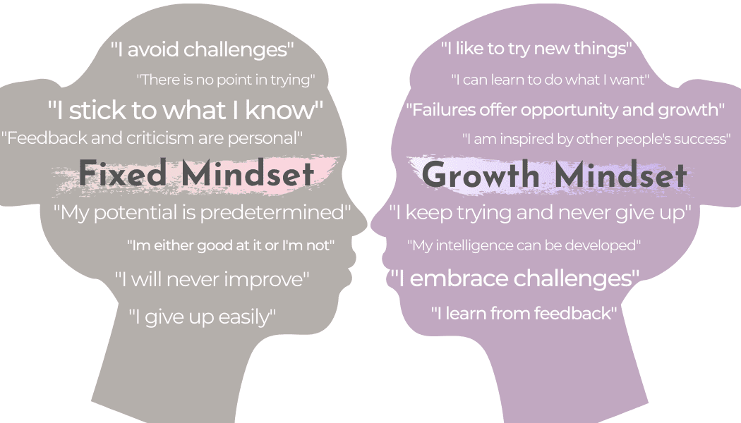
Fixed Mindset vs. Growth Mindset
A fixed mindset is based on the belief that your qualities are carved in stone
A growth mindset is based on the belief that your basic qualities are things you can cultivate through your efforts, your strategies, and help from others

Slide 5
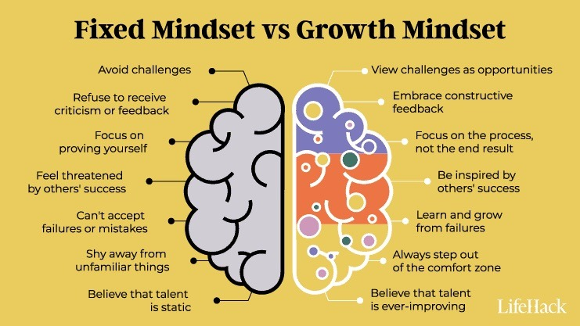
Notes:
Discuss infographic.

Slide 6
Fixed
Growth
“Spending time writing comments on documentation is a waste of time. No one ever uses it to improve.”
“Providing structured feedback takes time, but it’s worth the effort because it gives clients a sense of direction on what to do to improve.”
Staff
FEEDBACK
“Look at how many times staff had to prompt me with this task. The staff hates me. I guess I can’t do anything right for this staff. I’m done.”
“These prompts and comments are not what I expected, but at least now I know what kind of help to ask for from my staff.”
Client

Slide 7


Slide 8
Scenario Activity
How do you respond if you have a fixed mindset? A growth mindset?
You notice that some staff are not participating in group/team discussions. You suspect that it may be either shyness or that they are uncomfortable making mistakes or speaking publicly.
You are a student that just got your first test back. You received a D.

Slide 9

Notes:
Why does your mindset matter?

Slide 10
Why Mindset Matters
Helps create self confidence
Encourages collaboration and information seeking amongst others
Innovative & productive
Creates a happier/positive environment
How you process and reprocess events
Challenges become opportunities
Makes thoughts/changes become a reality
Increase in adaptability and perseverance

Slide 11


Slide 12
Strategies for Fostering Growth Mindset
Encourage a culture of learning
Set goals that challenge team members
Encourage feedback
Celebrate progress, not just success
Help team members see mistakes as learning opportunities

Slide 13
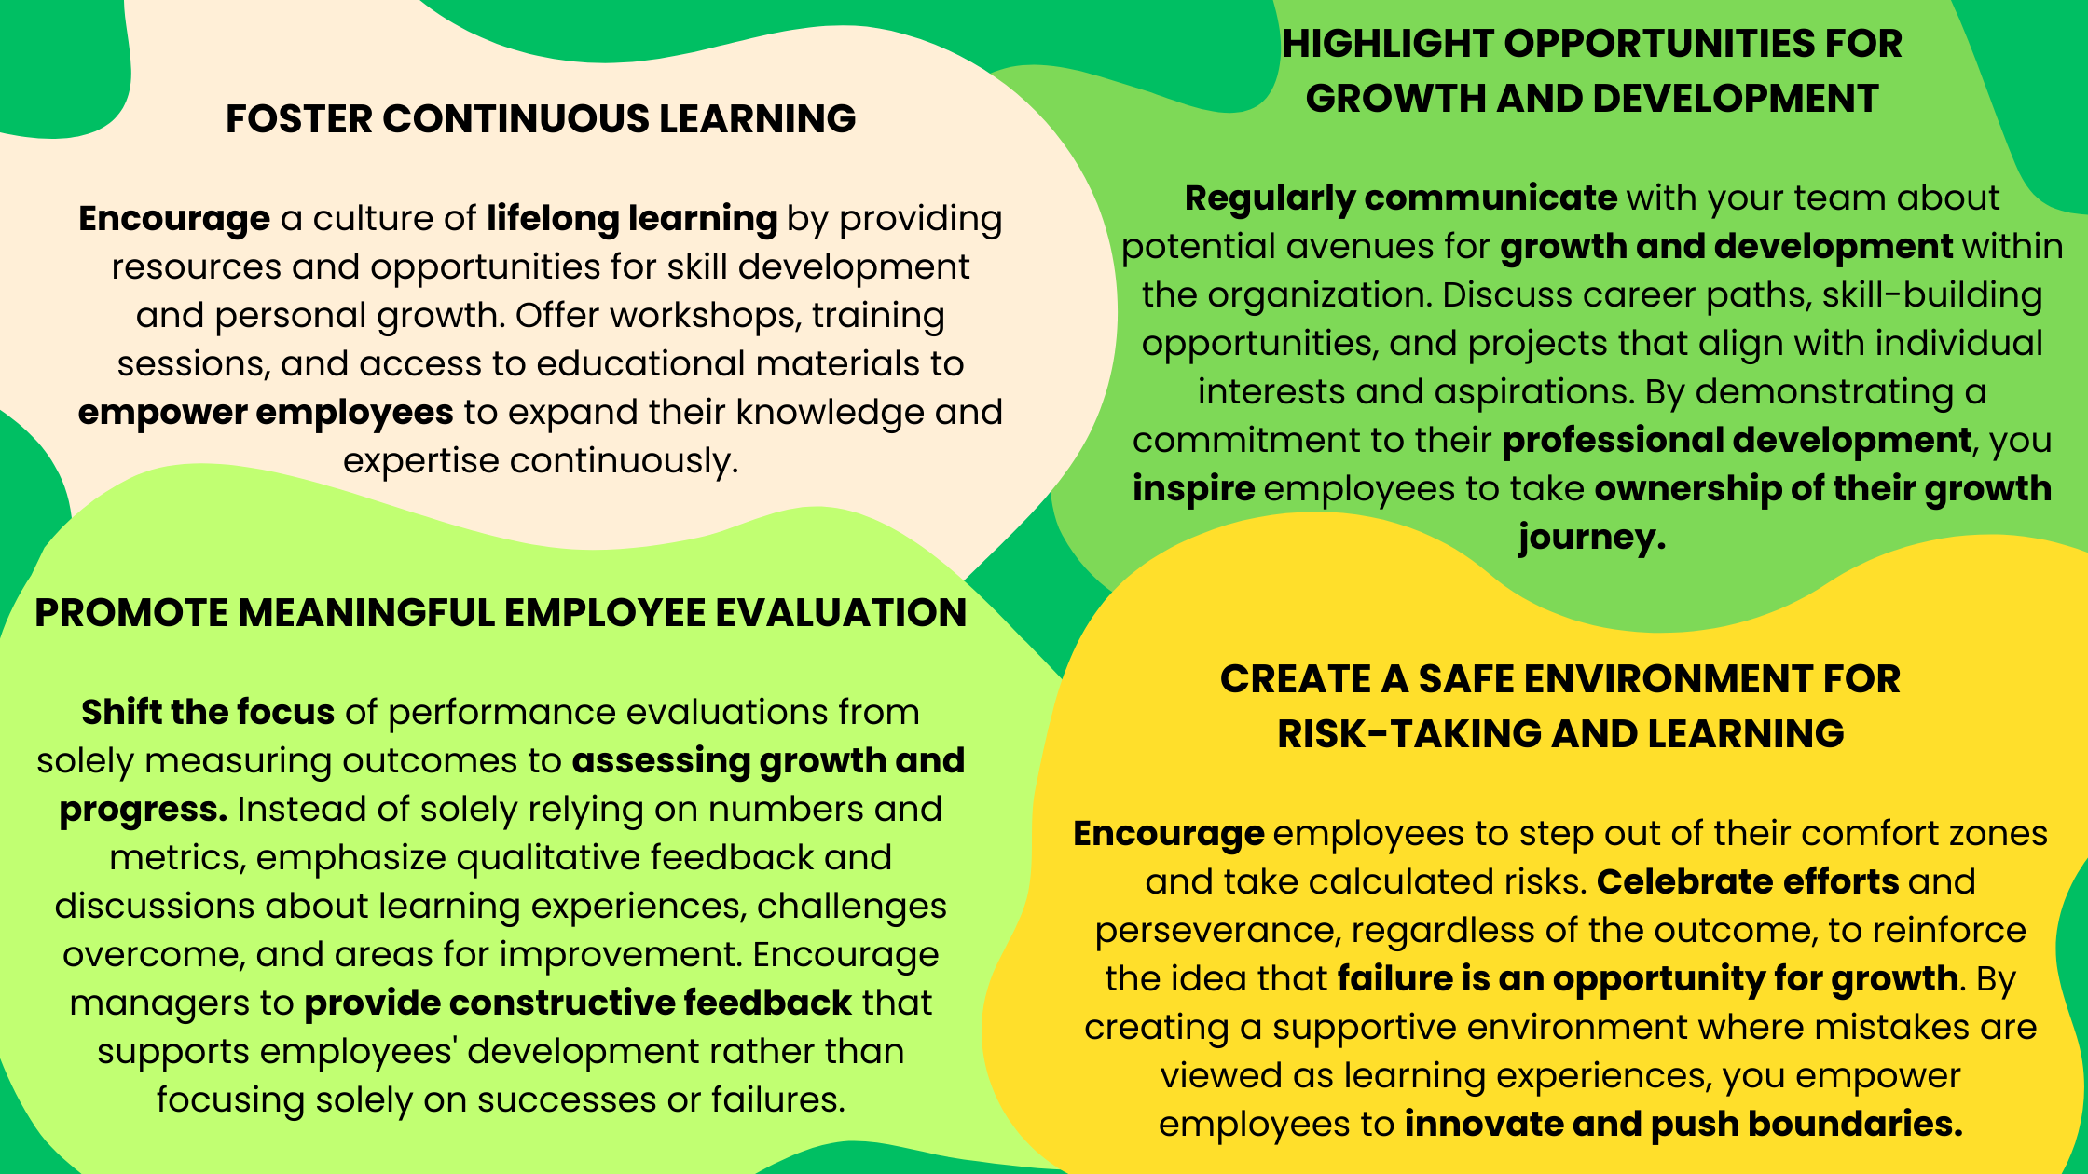

Slide 14
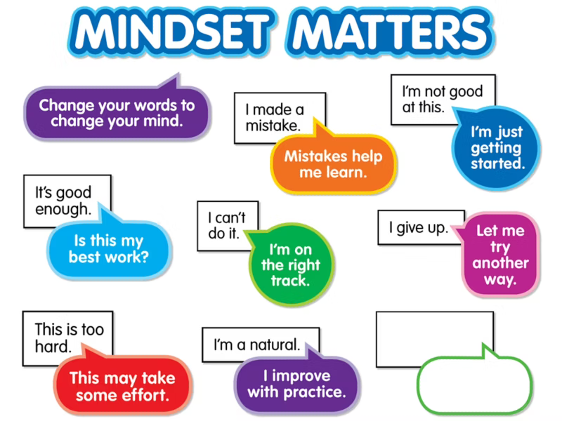

Slide 15
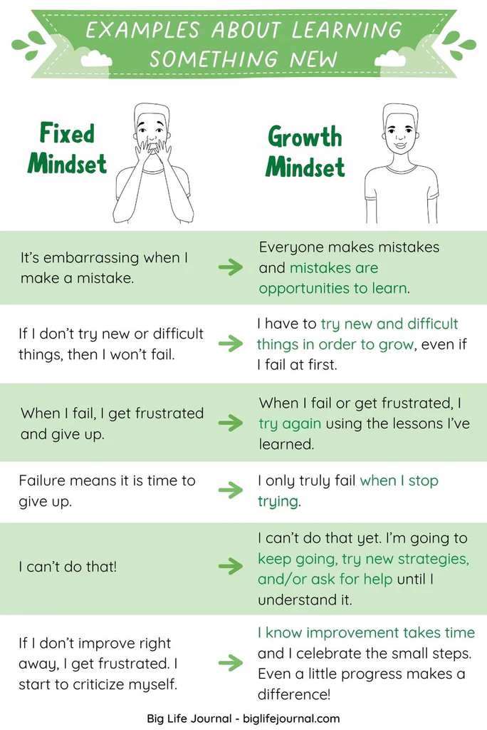
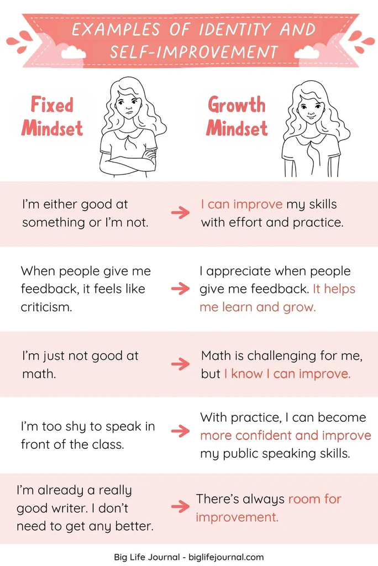

Slide 16
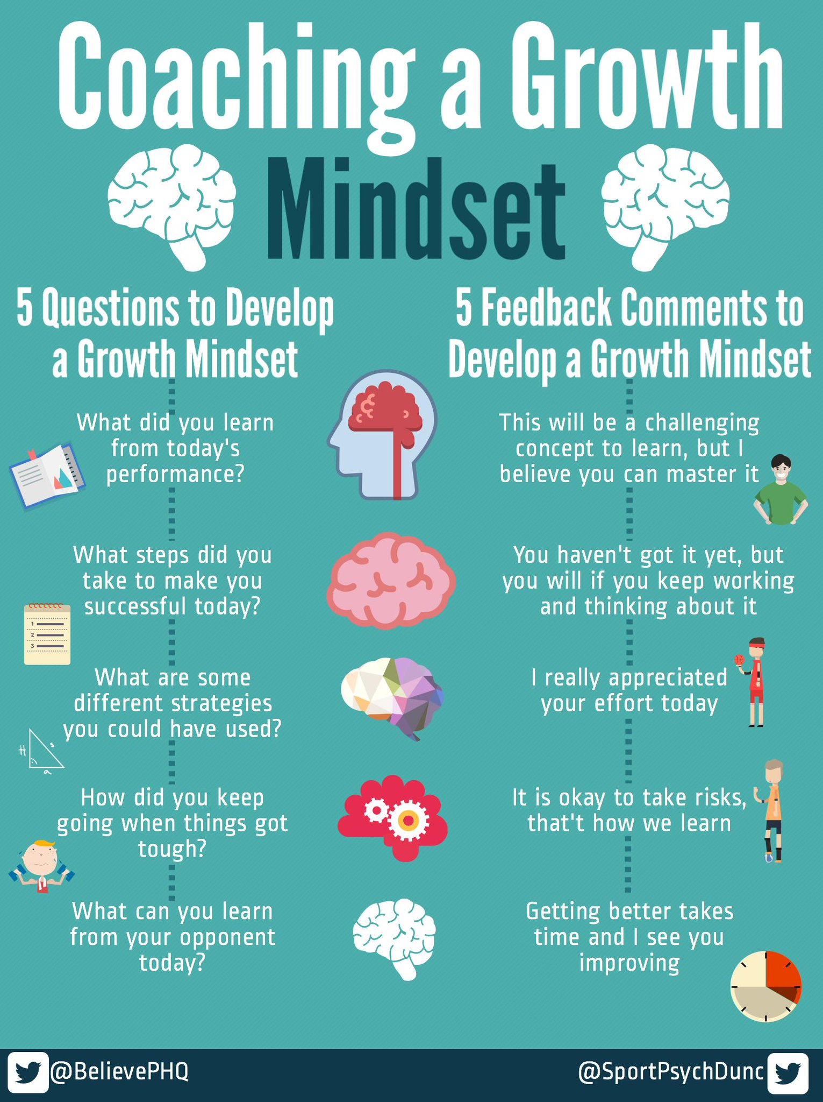
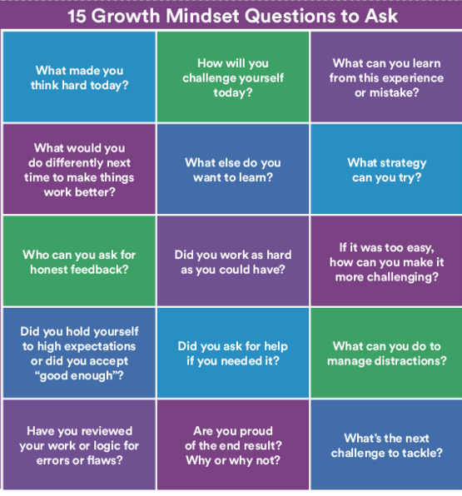

Slide 17
